Slide 1
EPA Clean Water Act Vessel Discharge Obligations and Maritime Standards Development Opportunities
Presented for ASTM Workshop: Opportunities for Maritime Standards Development
May 7, 2014
Ryan Albert

Slide 2
Outline
Brief Overview of Clean Water Act National Pollutant Discharge Elimination System (NPDES) Permitting
The Vessel General Permit (VGP)
Select VGP Categories (focusing on areas where there are opportunities for standards/methods development)

Slide 3
The Clean Water Act (CWA)
Established the National Pollutant Discharge Elimination System (NPDES) permit program
Any “point” source”
“discharge of a pollutant”
to “waters of the U.S.”
Must obtain NPDES permit coverage
(provides legal authority for those discharges of pollutants to waters of the U.S.)

Slide 4
NPDES Permitting
National Pollutant Discharge Elimination System (NPDES) Permits
  Individual permits and general permits
  Permit term not to exceed 5 years
  For EPA-issued permits, State water quality certification required

Slide 5
2013 Final Vessel General Permit – Overview
Effective December 19, 2013
  2008 VGP 5 year permit term expired
Jurisdiction of the permit
  Inland waters, territorial sea up to 3 nautical miles (nm)
Covers approximately 70,000 vessels while operating in U.S. Waters
Discharge coverage
  27 discharge types incidental to the normal operation of a non-recreational and non military vessels 79 feet or longer, except commercial fishing vessels, and all ballast water discharges, regardless of size
  Additional vessel class-specific conditions for 8 classes of vessels
  Certain vessel discharges not eligible for coverage(e.g., sewage)

Slide 6
2013 VGP – A Few Effluent Limits
Ballast Water
  Effluent limits, implementation schedule, and interim requirements
Bilgewater
  Monitoring for new vessels
Environmentally Preferable Products
Biofouling (underwater ship husbandry, anti-foulant hull coatings, sacrificial anodes)

Slide 7
Ballast Water – Numeric Effluent Limits
Section 2.2.3.5: Expressed as instantaneous maximum
Large Organisms (> 50μm) | Small Organisms (>10μ and ≤50 μm)
 |  | Toxigenic Vibrio cholerae (O1 & O139) | Eschericia coli | Intestinal enterococci
< 10 per m³ | < 10 per ml | <1 cfu per 100 ml | <250 cfu per 100 ml | <100 cfu per 100 ml

Slide 8
Ballast Water - Monitoring
Monitoring requirements if using a treatment device
  Functional
    Goal is to test if the system functioning as designed (e.g., applying chlorine dose, filtering water)
  Biological
    E. coli, enterococci, and total heterotrophic bacteria
  Active substance and residuals (for systems that use them)
    Numeric limits for systems using chlorine, chlorine dioxide, ozone, and peracetic acid
    Other parameters set at Gold Book values (if such systems were to be developed)
  Other monitoring approaches viable to ensure systems are meeting treatment limits (supplementing/replacing functional and biological monitoring?)

Slide 9
Bilgewater
Vessels greater than 400 GT must treat bilgewater to less than 15 ppm if they discharge (Same as MARPOL and APPS)
Presence of Oil Content Monitors (OCMs) allow EPA to not require extensive supplemental monitoring (looking toward preexisting standards)
  However, backscatter/turbidity OCMs suspected to be inaccurate at low oil concentration levels (Mclaughlin et al. 2014)
  Other OCM options available (e.g., UV fluorescence)?
Self-monitoring required for new build vessels
  New build vessels constructed on or after December 19, 2013 greater than 400 gross tons that discharge bilgewater must monitor their bilgewater effluent at least once a year for oil and grease content
  Waivers available after second year if vessel meeting 5 ppm level

Slide 10
Environmentally Preferable Products
Environmentally Acceptable Lubricants (EALs)
  All vessels must use EALs for all oil to sea interfaces, unless technically infeasible
  Oil to Sea interfaces include stern tubes, thrusters, hydraulic pitch propellers, wire rope lubrication, etc.
Minimally toxic cleaners and detergents
Phosphate free soaps and detergents
Notes:
(vegetable oils, synthetic esters, and polyalkylene glycols)
Stern tubes alone have been estimated to leak between 4.6 to 28.6 million liters of oil annually into ports worldwide

Slide 11
EAL Requirement
VGP Section 2.2.9: As of December 19, 2013, all vessels covered under the VGP must use EALs in all oil-to-sea interfaces, unless technically infeasible.
For purposes of the VGP, technically infeasible means:
  no EAL products are approved for use in a given application that meet manufacturer specifications for that equipment,
  products which come pre- lubricated (e.g., wire ropes) have no available alternatives manufactured with EALs,
  products meeting a manufacturers specifications are not available within any port in which the vessel calls, or
  change over and use of an EAL must wait until the vessel’s next drydocking.
Notes:
The intent of this new requirement is to reduce the environmental impact of lubricant discharges on the aquatic ecosystem by increasing the use of EALs for vessels operating in waters of the United States
We’ve found that stern tubes have been estimated to leak between 4.6 to 28.6 million liters of oil annually. Therefore we’ve required that new and existing vessels must use an Environmentally Acceptable Lubricant on all oil to sea interfaces – such as stern tubes, thrusters, pitch propellers, and wire ropes – unless the use of such product is technically infeasible.

Slide 12
What is an EAL?
EALs are lubricants that are “biodegradable” and “minimally-toxic,” and are “not bioaccumulative” as defined in Appendix A of the VGP.
Products meeting the permit’s definitions of an EAL include those labeled by the following voluntary labeling programs:
  Blue Angel, European Ecolabel , Nordic Swan, the Swedish Standards SS 155434 and 155470, Convention for the Protection of the Marine Environment of the North-East Atlantic (OSPAR) requirements, and EPA’s Design for the Environment (DfE)
Products that are not included in one of these labeling programs but have been tested to demonstrate compliance with the EAL definition may also be used to meet permit requirements.

Slide 13
What is an oil-to-sea interface?
Oil-to-sea interfaces include any mechanical or other equipment on board a vessel where seals or surfaces may release quantities of oil and are subject to immersion in any body of water.
The following list includes several onboard applications identified in the VGP, but there may be other applications:
  Controllable Pitch Propeller, Thrusters, Paddle Wheel Propulsion, Stern Tubes, Thruster Bearings, Stabilizers, Rudder Bearings, Azimuth Thrusters, Propulsion Pod Lubrication, Wire Rope, and Mechanical equipment subject to immersion (e.g., dredges, grabs, etc).
What about Seals that eliminate the interface?
Notes:
EPA does not consider rain to be a form of immersion.
Vessel operators are not required to use EALs in on-deck machinery so long as the equipment is not subject to immersion (i.e., does not have an oil-to-sea interface). However, discharges from deck machinery are subject to other discharge requirements, such as those for Deck Washdown and Runoff (Section 2.2.1 of the VGP), which recommends use of EALs.

Slide 14
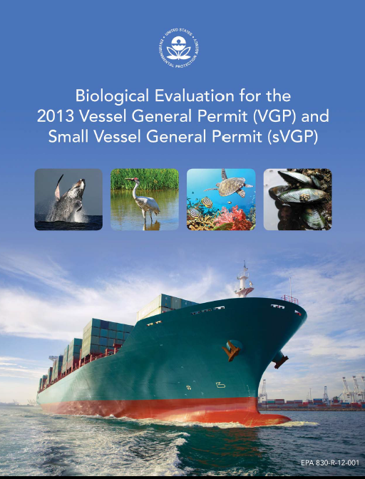
Biofouling
EPA recognizes that measures to manage biofouling are in early stages of development
Nonetheless, biofouling identified as one of the primary vectors for Aquatic Nuisance Species (ANS) introduction

Slide 15
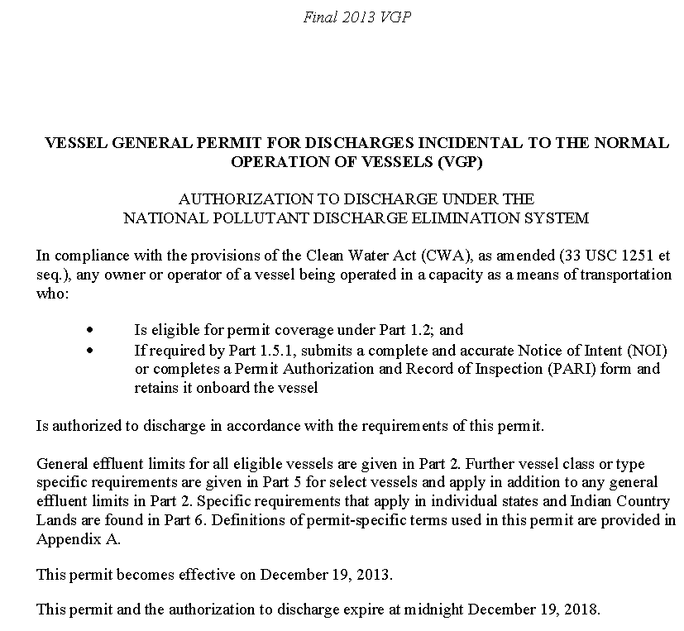
Biofouling
Biofouling regulated under 3 discharge types in the VGP
    Anti-foulant Hull Coatings
    Cathodic Protection
    Underwater Ship Husbandry (Primary Section)

Slide 16
Biofouling
Vessel operators must minimize fouling when not engaged in short distance voyages (from Underwater Ship Husbandry requirements):
  Management measures to minimize the transport of attached living organisms include:
    Selecting an appropriate anti-foulant management system and maintaining that system,
    Conducting an in-water inspection,
    Cleaning and maintenance of hulls, and
    Thorough hull and other niche area cleaning when a vessel is in drydock.
  Specified management measures consistent with IMO guidelines
When feasible, flush-fit sacrifical anodes to the hull or vessel fill the space between the anode and hull backing (From Cathodic Protection requirements)

Slide 17
Opportunities for Standard Development
Ballast Water
    Developing better self-monitoring indicators of Ballast Water Treatment System Performance
Bilgewater
  Improving OCM accuracy at low detection levels
Environmentally Acceptable Lubricants
  Standards for a seal that eliminates the “oil-to-sea” interface
  “Phosphate Free” “Minimally Toxic” and EAL component definitions”
Biofouling
  How should one flush fit anodes (if possible)
  What are sufficient inspections and maintenance of anti-foulant systems (and how clean is clean)

Slide 18
Questions?
Questions regarding this presentation:
  Ryan Albert - (202) 564-0763 or albert.ryan@epa.gov
General VGP questions
  VGP@epa.gov
  www.epa.gov/npdes/vessels
eNOI questions
  VGPeNOI@epa.gov
  www.epa.gov/npdes/vessels/enoi
Webinars
  EPA has held 4 webinars on the 2013 VGP
  The archived presentations are available at www.epa.gov/npdes/vessels

