Slide 1



Committee E55 Manufacture of Pharmaceutical and Biopharmaceutical Products
Ferdinando Aspesi - Chairman E55
www.astm.org

Slide 2
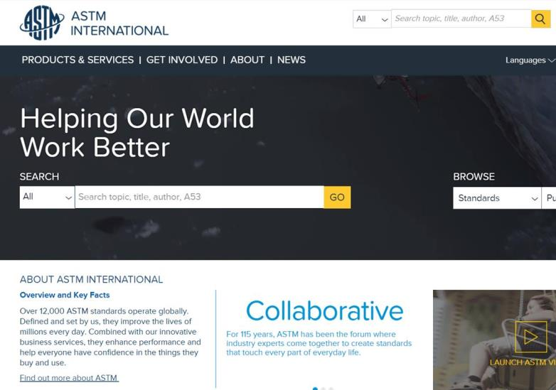
ASTM International
What is ASTM?
Organized in 1898
International Standards Developing Organization (SDO)
Non-governmental, not-for-profit organization
Over 12,000 International Standards
Over 34,000 Members
Over 145 Technical Committees
90 Industry Sectors

Slide 3
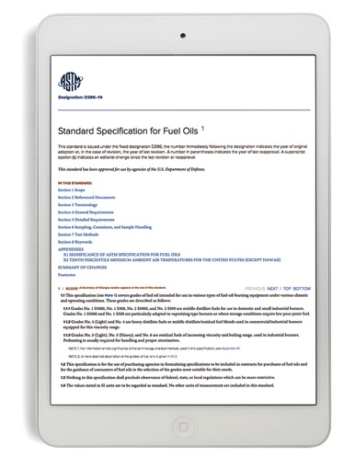
Effective and Relevant Around The World
  The Role of Standards
  Ensures safety, quality, and reliability
  Voluntary consensus process gives everyone
  an opportunity to participate – ensuring standards
  are effective and relevant across diverse markets
  Embracing all the principles of the World Trade Organization’s Agreement on Technical Barriers to Trade
  Incorporated into contracts, regulations, codes, and laws, they support established and emerging economies and free and fair global trade
  Constantly responding to new challenges, new technology and new markets

Slide 4
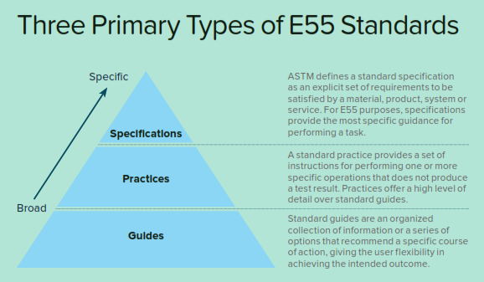
Importance of Standards
Standards have broad support from industry and International regulatory bodies
May be used as a basis for laws and regulations

Slide 5
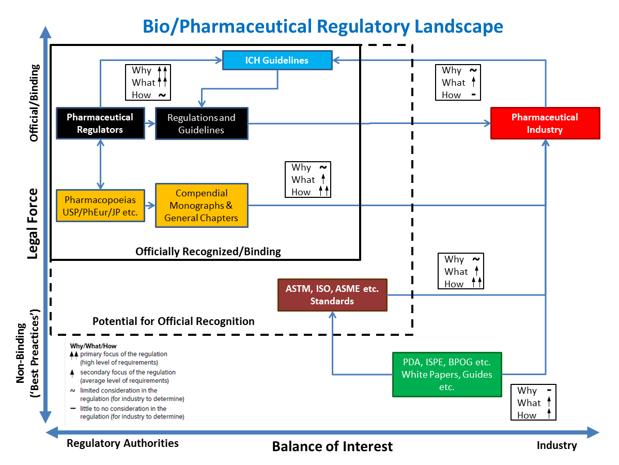
Pharma Regulatory Landscape

Slide 6
E55 Committee Scope and History
Scope: development of standardized nomenclature and definitions of terms, recommended practices, guides, test methods, specifications, and performance standards for the manufacture of pharmaceutical and biopharmaceutical products
Formed in 2003 under previous title “Pharmaceutical Application of Process Analytical Technology”
      Improve efficiency, process control, safety, and ultimately, product quality and public health
In 2006, E55 expanded to address all aspects of pharma, changing to current title “Manufacture of Pharmaceutical Products”
In 2015, E55 again expanded to meet industry’s needs to the title of “Manufacture of Pharmaceutical and Biopharmaceutical Products”

Slide 7
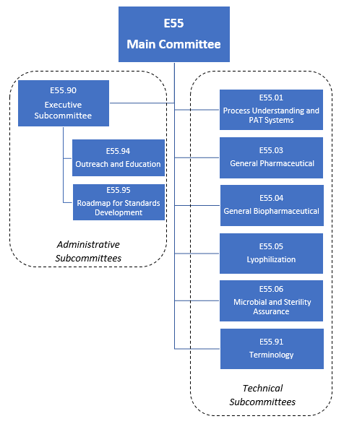
E55 Committee Structure
E55 Technical Subcommittees develop standards within their scope
All standards must be approved at the Subcommittee and Main committee
Administrative Subcommittees oversee various tasks around the development of E55 standards as well as the operations of the full Committee

Slide 8
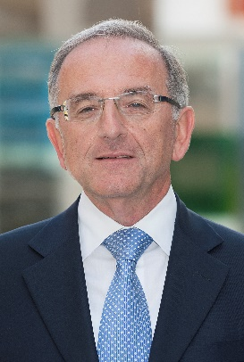

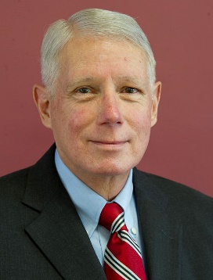

Subcommittee E55.90 Executive
Chair
Ferdinando Aspesi
Bridge Associates International, LLC
Vice Chair
Russ Madsen
The Williamsburg Group, LLC
Recording Secretary
Rick Van Doel
Performance Validation
Membership Secretary
Claus Weisemann
NGMBio

Slide 9

Subcommittee E55.01
Process Understanding and PAT System Management, Implementation and Practice
Chair: Benoit Inge
  Vertex
Scope: Develops standards focused on pharmaceutical process understanding, process design, control, and optimization as well as the implementation and practice of process analytical technology
Covers PAT system management, implementation and practice, allowing it to be highly effective in response to industry needs
80 Members
8 Current standards, including:
  E2474 Practice for Pharmaceutical Process Design Utilizing Process Analytical Technology
  E2475 Guide for Process Understanding Related to Pharmaceutical Manufacture and Control
  E2968 Guide for Application of Continuous Processing in the Pharmaceutical Industry
  E3177 Guide on Sampling for Process Analytical Technology

Slide 10

Subcommittee E55.03
General Pharmaceutical Standards
Chair: Paul Gil
Scope: Develops general principles, practices, and related standards for managing quality in the pharmaceutical industry
Covers design and verification of manufacturing systems and equipment, continuous quality verification, real-time release testing, testing of uniformity of dosage units, qualification of basket and paddle apparatus, science and risk-based cleaning processes, particle analysis, and single-use system design and verification
100 Members
10 Current standards, including:
  E2500 Guide for Specification, Design, and Verification of Pharmaceutical and Biopharmaceutical Manufacturing Systems and Equipment
  E2503 Practice for Qualification of Basket and Paddle Dissolution Apparatus
  E2810 Practice for Demonstrating Capability to Comply with the Test for Uniformity of Dosage Units
  E3106 Guide for Science-Based and Risk-Based Cleaning Process Development and Validation

Slide 11

Subcommittee E55.04
General Biopharmaceutical Standards
Chair: Jeff Carter
  Cytiva
Scope: Development of standardized nomenclature and definitions of terms, recommended practices, guides, test methods, specifications, and performance standards for the manufacture of biopharmaceutical products
Covers emerging needs specific to bioprocessing, biologics, and biotherapeutics
100 Members
6 Current standards, including:
  E1564 Guide for Design and Maintenance of Low-Temperature Storage Facilities for Maintaining Cryopreserved Biological Materials
  E1565 Guide for Inventory Control and Handling of Biological Material Maintained at Low Temperatures
  E1566 Guide for Handling Hazardous Biological Materials in Liquid Nitrogen
  E2097 Guide for Determining the Impact of Extractables from Non-Metallic Materials on the Safety of Biotechnology Products

Slide 12

Subcommittee E55.05
Lyophilization
Chair: Arnab Ganguly
  Amgen
Scope: Develop standard guides and practices relevant to the lyophilization of parenterals and other pharmaceutical and biological products
Covers aspects of lyophilization process and equipment design, operation and qualification, quality assessment, process understanding and control
Formed and led by LyoHUB
Near completion of 1st draft standard:
  WK63507 Best Practices for Process Monitoring Instrumentation in Pharmaceutical Freeze Drying

Slide 13

Subcommittee E55.06
Microbial/Sterility Assurance for Pharmaceutical and Biopharmaceutical Products
Chair: Scott Drummond
  Johnson & Johnson
Scope: Development of test methods, specification and performance standards for the microbiological quality of pharmaceutical and biopharmaceutical products
Topics for possible standards:
  Post Sterilization Filter testing (Practice or Guidance)
  Contamination Control strategy (Guidance)
  Release Testing Strategy i.e. Parametric or RTRT (Guidance)
  SUS, Leak Testing Post Use (Guidance and/or Test Methods)
  Integrity testing (Guidance and/or Test Methods)
  Garment controls (Practice or Guidance)

Slide 14

Subcommittee E55.91
Terminology
Chair: Alain Pralong
  Pharma-Consulting ENABLE GmbH
Scope: The development, evaluation, and compilation of terminology for pharmaceutical and biopharmaceutical applications relevant to Committee E55
55 members
1 current standard
  E2363 Standard Terminology Relating to Process Analytical Technology in the Pharmaceutical Industry

Slide 15
E55 Proposed New Standards
E55.01
WK74957 New Guide for PAT System Applications in Biopharmaceutical Industry
E55.03
WK64938 New Practice for Calculation of Cleaning Validation Limits
WK67425 New Practice for Standard Practice Guide for the Qualification of Visual Inspection of Pharmaceutical Manufacturing Equipment and Medical Devices for Residues
WK72293 New Guide for Standard Guide for Definition of Combination Products
WK74514 New Practice for Measurement of Particulate Matter in Pharmaceuticals using Automated Membrane Microscopy
E55.04
WK64991 New Practice for Stability of Early Phase Protein Products
WK65428 New Guide for the Application of Continuous Processing in the Biopharmaceutical Industry
WK65429 New Practice for Process to Remove Retrovirus by Small Virus Retentive Filters
WK74440 New Test Methods for Physical Integrity Testing of Single-Use Systems
E55.06
WK69660 New Guide for Guidance on Microbiological Quality & Prevention Strategy
WK69826 New Guide for Standard Template for Environmental Monitoring (EM) Trend Analysis
WK74412 New Guide for Critical Airflow Visualization

Slide 16
E55 Membership
ASTM Membership is open to all
Diverse stakeholders
  200+ members representing
    Industry; pharma, biopharma, suppliers
    Government
    Academia
    Standards Development Organizations
    General interest; professional orgs, trade associations, etc.
International Membership including
  Belgium, Canada, Chile, China, Denmark, France, Germany, Ireland, Japan, Luxembourg, Malta, Mexico, Nepal, New Zealand, Peru, Singapore, Spain, Switzerland, United Kingdom, & United States

Slide 17
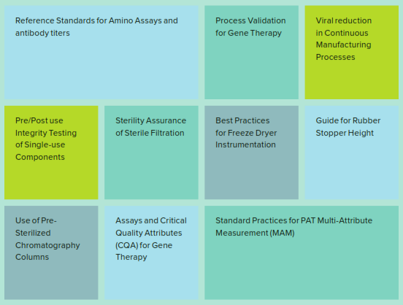
Topics for Future Standards

Slide 18

Responding to Growing needs in Product/Treatment Manufacturing
New Areas of Interest
This Photo by Unknown Author is licensed under CC BY-SA

Slide 19
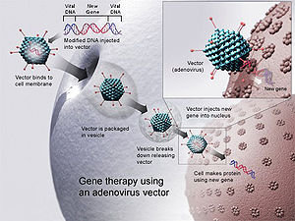
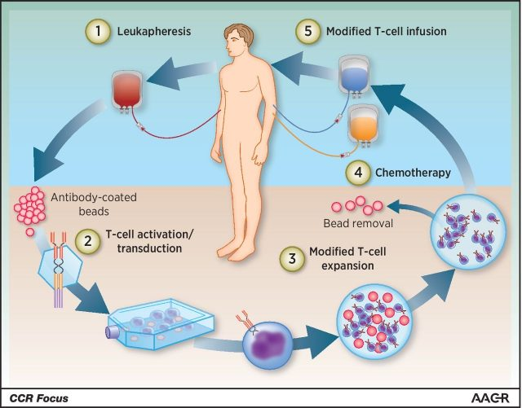
Responding to Growing needs in Product/Treatment Manufacturing (I)
Cell Therapy
  (E55.04)
Gene Therapy
  (E55.04)
Notes:
Again, I recommend we pick different graphics, or people will be trying to read and understand these.

Slide 20
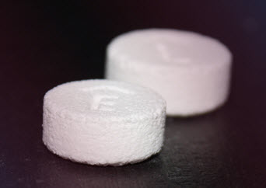
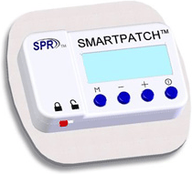
Responding to Growing needs in Product/Treatment Manufacturing (II)
Combination Products
  (E55.03)
Pharmaceutical 3D Manufacturing
  (E55.03)

Slide 21

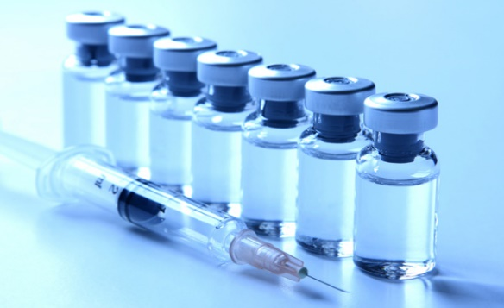
Responding to Growing needs in Product/Treatment Manufacturing (III)
Cancer Vaccines
  (E55.04)
Artificial Intelligence in Pharmaceutical and Biopharmaceutical Industry
  (E55.03 or 01)

Slide 22
How can you help shape the Future?
Join ASTM E55!
  Can participate as a non-member, but you cannot vote.
Join Sub- Committees as you choose- fits your interest and needs.
You can help influence and guide our industry
  Helping to determine what standards get written
  Voting on content of standards
  Helping to update and re-invigorate existing standards to improve them and remain relevant.

Slide 23
Thank you

