Slide 1


Standards Development and Intellectual Property Protection
Learning Module Series
Notes:
Welcome to ASTM International. This learning module is designed to provide you with an overview of copyright and the role of intellectual property protection in the field of standards development. Commercial standards are extremely important tools in the engineering world and other areas of research, development, design, quality, and testing. New electronic tools have enhanced the delivery and accessibility of standards, however, many users are unaware standards are copyrighted documents, and thus subject to strict laws and guidelines with regard to reproducing, sharing electronically, or hosting on internal or public networks. Discussed will be the important ethical trends and copyright-related issues impacting the delivery of standards and what leading standards development organizations like ASTM are doing to address the challenge of intellectual property protection.

Slide 2
Standards Development and Intellectual Property Protection
Learning Module Series
Notes:
Welcome to ASTM International. This learning module is designed to provide you with an overview of copyright and the role of intellectual property protection in the field of standards development. Commercial standards are extremely important tools in the engineering world and other areas of research, development, design, quality, and testing. New electronic tools have enhanced the delivery and accessibility of standards, however, many users are unaware standards are copyrighted documents, and thus subject to strict laws and guidelines with regard to reproducing, sharing electronically, or hosting on internal or public networks. Discussed will be the important ethical trends and copyright-related issues impacting the delivery of standards and what leading standards development organizations like ASTM are doing to address the challenge of intellectual property protection.

Slide 3
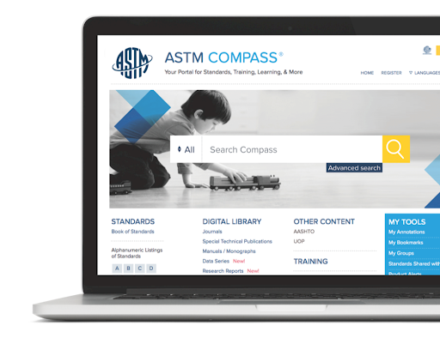

Background
Strong increase in electronic information
Entertainment, educational, and business content available at users' fingertips
Instant information: High-speed Internet delivers content in seconds
©2025 Proprietary and Confidential. All Rights Reserved.
Notes:
The continued growth of the Internet and powerful networking technologies has resulted in a monumental increase in the delivery and use of electronic information. With just a few clicks of the mouse, people anywhere in the world can now download digital media and information of all kinds. And with the advent of broadband and other high-speed Internet connections, the information is there and ready for use literally in seconds.

Slide 4


Impact of the Digital Age
Intellectual Property Protection
Publishers must protect their most valuable asset
Widespread issue - illegal copying and unauthorized use
Bottom-line implications for many organizations
©2025 Proprietary and Confidential. All Rights Reserved.
Notes:
While the digital age has provided a wealth of benefits for information consumers, it has also brought growing intellectual property challenges for publishers of electronic content who rely on sales to fund their operations. Today, more than ever before, electronic publishers must work diligently to protect their most valuable asset – their intellectual property – from illegal distribution and other unauthorized use.

Slide 5

The Challenge for SDOs
Digital Age Dilemma
Standards developers face growing intellectual property concerns
Illegal reproduction and unauthorized use is a real issue
©2025 Proprietary and Confidential. All Rights Reserved.
Notes:
The electronic information age has also increased the visibility and availability of voluntary consensus standards. Through its ongoing digital path initiatives, ASTM International continues to leverage technology to expand global participation in standards development activities, facilitate transparent access to the standards process, and make the delivery of ASTM standards to users easier than ever before. The downside of this technological advancement is that standards development organizations now face intellectual property challenges similar to those of other electronic information publishers. The illegal reproduction and sharing of standards and related technical information are a growing concern in the standards community.

Slide 6

Defining the Problem
Common Occurrences
Individual purchases one standard and e-mails it to numerous colleagues
ASTM standards posted on public Internet sites – open access and free download
Companies purchase standards and place them on internal Intranet site without the proper license
©2025 Proprietary and Confidential. All Rights Reserved.
Notes:
To better illustrate the intellectual property problem faced by standards development organizations, let’s take a quick look at some common occurrences. For this discussion, we’ll use some examples that ASTM has encountered:An individual purchases a single ASTM document in PDF format and then proceeds to e-mail it to numerous colleagues. ASTM standards, purchased through legal means, are posted illegally on open public Internet sites, so anyone can access the documents and reproduce them.Another common situation involves companies that purchase individual user subscriptions and then, without the proper license, place downloaded documents on a company Intranet for many others to use on an unlimited basis.All of these examples illustrate copyright violations and a violation of the terms of the licensing agreement pertaining to the copying and use of ASTM standards.

Slide 7

What's at Stake?
Impact on health of standards development organizations
Revenue from standards sales helps to further continued standards development and ongoing operations
Adversely impacting marketplace needs for new standards
©2025 Proprietary and Confidential. All Rights Reserved.
Notes:
For standards development organizations (SDO’s), violations of intellectual property rights can have consequences that can impact their continued financial health and vitality, as well as the work of their members. Many SDOs, such as ASTM International, rely primarily on the sale of standards and related publications to fund their ongoing operations. For example, approximately 75 percent of ASTM’s revenue is derived from the sale of copyrighted standards and other technical information. When intellectual property is obtained by users in an unauthorized manner, standards developers lose income that is rightly theirs. These same lost dollars are needed to support the ongoing work of members in developing new and needed standards for society. Along the same lines, some SDOs find themselves having to invest in infrastructure to protect intellectual property, perhaps at the expense of member-related services. Ultimately, consumers and other standards users suffer if new standards fail to reach the marketplace as a result.

Slide 8
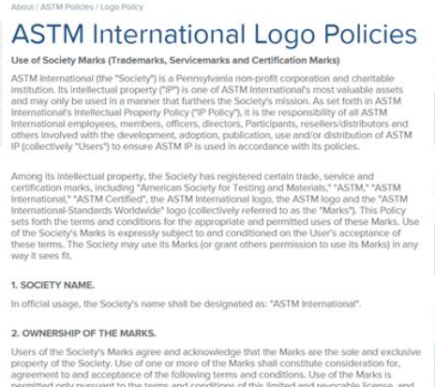
Addressing the Issue
ASTM's Approach:
Intellectual property, logo, and licensing policies
Digital rights management
Educational initiatives
©2025 Proprietary and Confidential. All Rights Reserved.
Notes:
ASTM International has taken a lead role in the standards development community in addressing intellectual property protection. ASTM’s multi-faceted approach includes bringing greater visibility to the issues, and working with users, members and the worldwide SDO community. Internally, ASTM has taken a number of important steps to protect its intellectual property and the ability of its members to continue to rapidly develop innovative standards that serve the marketplace and society. These steps include:Intellectual property, logo usage, and licensing policiesDigital rights management, such as watermarkingEducational initiatives

Slide 9

Intellectual Property and Logo Policies
Readily accessible on ASTM website
Clear guidelines on use and protection of ASTM intellectual property
Details proper use of ASTM logo
Branding opportunities for organizational members
©2025 Proprietary and Confidential. All Rights Reserved.
Notes:
ASTM International has a clear and concise Intellectual Property Policy that is readily available in a public forum on its website. The policy defines the scope of ASTM intellectual property and spells out how it can be used, how it is to be protected, and also how intellectual property owned by other organizations can be included in the development of ASTM standards. ASTM’s current logo policy is also simple and straightforward, and easily accessible on the ASTM website. It details how ASTM’s logo can be used with written permission to designate membership in ASTM and a link to ASTM’s website. Organizational members of ASTM International often utilize the ASTM logo to enhance their branding and marketing efforts.

Slide 10
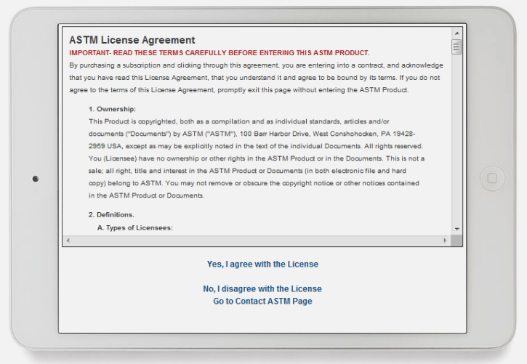
Licensing Policy
Applies to electronic downloads of ASTM standards
Users must agree to terms and conditions before purchasing an ASTM standard
ASTM grants a limited, nonexclusive, nontransferable license
Licenses available for WAN or Intranet use
©2025 Proprietary and Confidential. All Rights Reserved.
Notes:
ASTM International also provides a licensing policy that applies to electronic downloads of standards from the ASTM website. Simply stated, when users want to download an ASTM standard, they must click through the license agreement and agree to the terms and conditions set forth in the policy. ASTM grants a limited, nonexclusive, nontransferable license on the use of its standards and related publications. The same or similar terms apply if a user purchases an electronic version of an ASTM document from a re-seller or third-party provider. Licenses are also available for wide area network or Intranet use.

Slide 11
Digital Rights Management
Electronic watermarking of all downloaded ASTM standards (PDF format)
Program locates inappropriately posted ASTM documents on the Internet
©2025 Proprietary and Confidential. All Rights Reserved.
Notes:
To further protect its intellectual property, ASTM has implemented a digital rights protection program. A key component of this program is electronic watermarking of all downloaded standards in PDF format. Each time a user downloads an ASTM standard a watermark is stamped on the document. This identifies the individual or company that purchased the standard; the location where it was downloaded; and the authorized licensing terms. In addition, ASTM also utilizes a program that locates ASTM documents which are publicly and inappropriately posted on the Internet.

Slide 12

Education
Violations occur due to lack of understanding on the issues
Failure to read licensing terms
Lack of standardized licensing terms in SDO community
ASTM: Focus on education to reduce future mistakes
©2025 Proprietary and Confidential. All Rights Reserved.
Notes:
ASTM’s underlying approach to intellectual property protection is based on education and awareness. Many violations that occur are a result of users not thoroughly understanding the issues related to intellectual property protection or taking the time to completely read important licensing terms. A lack of standardized licensing or usage terms throughout the SDO community also can lead to confusion – as users purchase standards from multiple organizations. ASTM is currently working cooperatively with other standards developers to address this issue. Through various educational efforts, ASTM International will continue to create awareness concerning intellectual property protection and user responsibilities so that mistakes may be avoided in the future.

Slide 13
Moving Forward
ASTM International:
Protecting its vital intellectual property assets to better serve the world’s need for voluntary consensus standards
©2025 Proprietary and Confidential. All Rights Reserved.
Notes:
ASTM International will continue to provide an open and transparent forum for the timely development and delivery of voluntary consensus standards. By properly protecting its valuable intellectual property, ASTM can better ensure that the needs of society for high quality, market relevant standards will be met for generations to come.

Slide 14
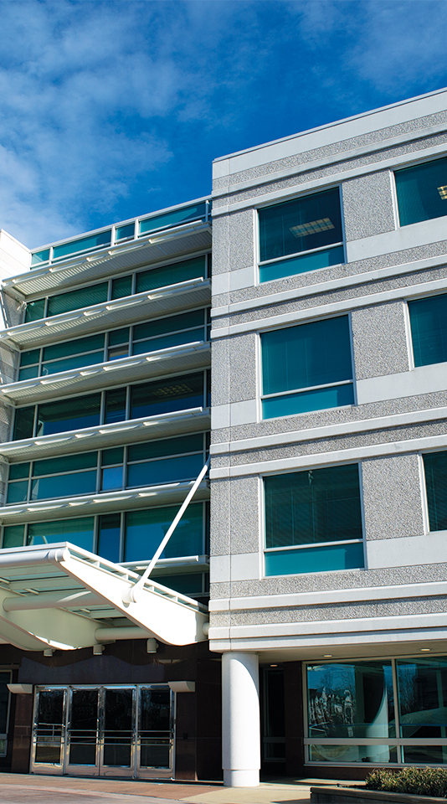
Thank you
Learning Module Series
Notes:
We hope that this learning module has brought you closer to the world of ASTM standards and offered interesting perspective on the ways they impact our daily lives. To learn more about the field of standardization and ASTM International, please view our other learning modules or visit the ASTM website at www.astm.org.

