Slide 1
Module 3: Application of Game Theory, Trust Constructs, and Cross Cultural Competencies to Promote Cooperation in Voluntary Standards
Joseph Sinicrope
Research Scientist, FIU Applied Research Center
Chair, Committee on Technical Committee Operations
Vice Chair, E10 Committee on Nuclear Technology and Applications
Chair, E10.03 Committee on Decommissioning of Nuclear Facilities and Components
Notes:
Consensus standards provide many functions in promoting trade and facilitating technology development, acceptance, and diffusion. Depending on the unique characteristics and nature of any given industry, certain functions will be emphasized / prioritized differently to address the most pressing obstacles associated with technology acceptance in that industry. Using safety-critical industries as an example, this module highlights how standards serve as critical enablers in risk mitigation by increasing transparency and information symmetry across the primary stakeholders. The flow of the material is intended to raise the student’s awareness by highlighting the importance of analyzing external environmental factors on organizational culture (soft skills), and then introduce several empirical-based theoretical concepts that provide the academic underpinnings of how standards can be strategically integrated to address those distinct requirements and anomalies. The strategic goal for this module is to increase the students’ overall awareness that the characteristics of an industry, and by extension its culture, impact the way that innovation and technology are accepted and diffused. Subsequently, this can impact the role standards will play in overcoming obstacles, and it informs the emphasis of Technical Committees in the development of standards.

Slide 2
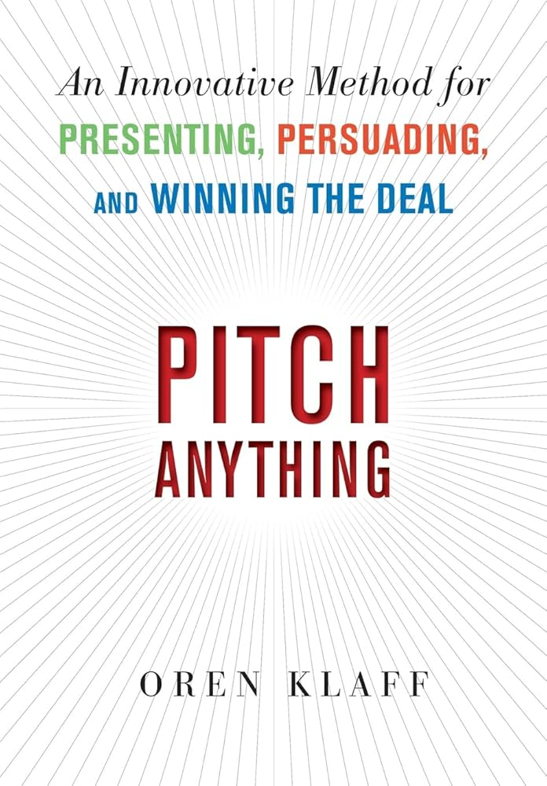
Scene Setter
Game: 5 pairs of students are lined up on opposite sides of a line. The objective is to get the opposite person from you to cross the line to the other side. Winners receive $1000.
Win-Win Solution:
$10K Max Value
Zero Sum Approach:
$5K Max Value
$0
$0
Zero-Sum
Approach
$0
$1000
  Cultural conditioning can impact
  interpretation of the rules and, by
  extension, potential solutions
  Default to zero-sum, “winner takes
  all” mentality
Positive-sum approaches facilitate
varying degrees of win-win scenarios for
all stakeholders
$500
$500
$.01
$999.99
Positive-Sum
Approach
$1000
$1000
  Can maximize social value
$5000
$5000
$2000
$3000

Slide 3
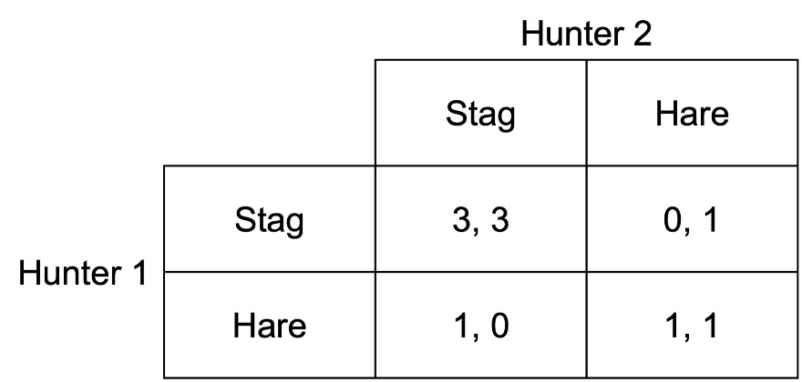
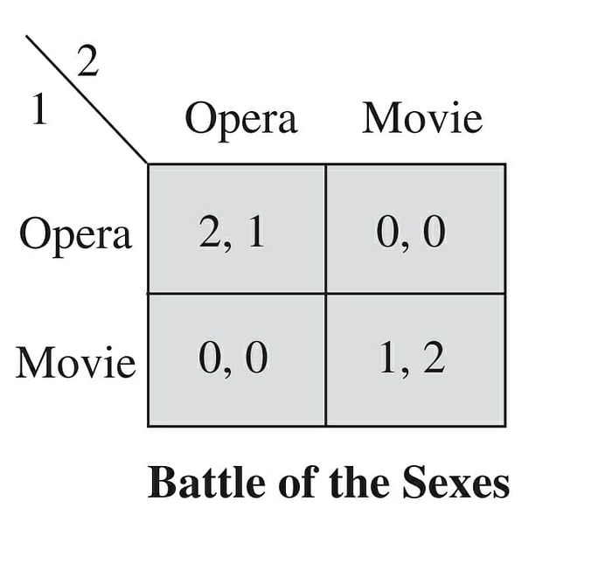
Why Game Theory?
Provides framework that enhances understanding of the conditions under which cooperation is likely to occur
Key Game Theory Terms:
  Payoff Matrix – Possible outcomes based on strategic choices
  Nash Equilibrium (NE) – Maximizes individual payoff
  Pareto Optimal (PO) – Maximizes collective payoff
  Drivers for Cooperation
    Positive Network Externalities (individual stakeholder payoffs are highest through cooperation)
    Incentivizes stakeholders to pursue strategies that promote some level of cooperation (NE=PO)
  Scenarios
    “Stag Hunt” – Getting to Pareto Optimal involves risk and requires trust
    “Battle of the Sexes” – Getting to Pareto Optimal requires balancing different preferences and can produce the perception of unfairness
Stag Hunt: Cooperation dominates defection

Slide 4
Game Theory and the Role of Standards Development Organizations (SDOs) like ASTM
Research findings on Game Theory applications for the role of Standards Development Organizations (SDOs)
  Facilitate coordination and commitment
  Improve information exchange (reduce information asymmetry)
  Promote cooperation
  In the view of Game Theory, institutions serve as multipurpose and multifaceted efficiency-enhancing devices over the long-term
    For “Stag Hunt” scenarios, SDOs mitigate risk and build trust among stakeholders
    For “Battle of the Sexes” / “Different Standard Preference” scenarios, SDOs facilitate the convergence of stakeholder strategies towards a common Pareto Optimal equilibrium
A standardization game
Firm 2
Standard 1 Standard 2
Firm 1
Standard 1 (4.2) (1.1)
Standard 2 (0.0) (2.4)
Notes:
Diffusion of Innovation Theory: Diffusion of Innovation Theory was first proposed by E.M. Rogers in 1962. It is intended to help explain how a technology or innovation gains momentum and diffuses (or spreads) across various groups within a specific population or social system. However, the characteristics of each designated group outlined in Roger’s Diffusion Theory (i.e.: innovators, early adopters, early majority, late majority, and laggards) are relative as they are largely influenced by the broader industry culture. The instructor can introduce the concept, and then encourage the students to do some critical thinking and articulate how this theory may be applied differently in safety-critical industries. The instructor could introduce the cross-cultural competence concept of “mirror imaging” and demonstrate that the characteristics of “innovator” in one industry could be very different than they are in another industry. The end state, much like the TAM discussion, is that the students gain an appreciation of not just the theory itself, but how it operates and/or is modified across different domains by factors such as culture.

Slide 5
Voluntary Standards as Trust Constructs
•Choose between the two fixative technologies based on the given information:
•Technology 1: Incombustible fixative intended to maintain stabilization of residual radioactive material when exposed to fire contingency scenarios outlined in safety basis documents. $0.75 / square foot. Met ASTM E84, NFPA 701, and UL723 fire test standards.
•Technology 2: Incombustible fixative intended to maintain stabilization of residual radioactive material when exposed to fire contingency scenarios outlined in safety basis documents. $0.75 / square foot.
•Choose between the two fixative technologies based on the given information:
•Technology 1: Incombustible fixative intended to stabilize residual radioactive material when exposed to fire contingency scenarios outlined in safety basis documents. $1.00 / square foot. Met ASTM E84, NFPA 701, and UL723 fire test standards.
•Technology 2: Incombustible fixative intended to stabilize residual radioactive material when exposed to fire contingency scenarios outlined in safety basis documents. $0.75 / square foot.
Thought for Consideration: Use of consensus standards can positively influence technology selection, adoption, and diffusion – BUT WHY?

Slide 6
Voluntary Standards as Trust Constructs
What factor weighed most heavily in your adoption of the new technology?
Trust Constructs Sample Mean
Similarity between the new and old 0.227
technology
Met Industry standards 0.372
Standards referenced in 0.429
regulations
Return Policy 0.145
Warranty 0.362
Bahmanziari et al, 2016

Slide 7
Processes as Trust Constructs
  Balanced membership and voting interests
  Due Process
  Broad-based consensus – find common ground – unanimity is not necessarily required, but a simple majority will NOT pass muster
  Transparency and Open participation
  Right to Appeal
  Due Process
  Broad-based consensus – find common ground – unanimity is not necessarily required, but a simple majority will NOT pass muster
  Transparency and Open participation
  Due Process
  Broad-based consensus – find common ground – unanimity is not necessarily required, but a simple majority will NOT pass muster
  Transparency and Open participation
  Right to Appeal
Key Takeaway: Each addition to the process is designed to enhance trust and, by extension, further promote cooperation among the stakeholders

Slide 8
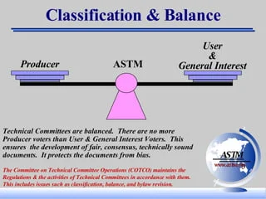
The Consensus Process as a Trust Construct
Key Pillars of the Consensus Process:
  Balance
    Membership and Voting Interests – no undue influence- Diversity of interests and viewpoints
  Due Process
  Broad-based consensus – find common ground – unanimity is not necessarily required, but a simple majority will NOT pass muster
  Transparency and Open participation
  Right to Appeal
End State: Build trust and utility while mitigating risk via a collaborative, proven process that produces standards of the highest technical integrity and global market relevance.
Notes:
Diffusion of Innovation Theory: Diffusion of Innovation Theory was first proposed by E.M. Rogers in 1962. It is intended to help explain how a technology or innovation gains momentum and diffuses (or spreads) across various groups within a specific population or social system. However, the characteristics of each designated group outlined in Roger’s Diffusion Theory (i.e.: innovators, early adopters, early majority, late majority, and laggards) are relative as they are largely influenced by the broader industry culture. The instructor can introduce the concept, and then encourage the students to do some critical thinking and articulate how this theory may be applied differently in safety-critical industries. The instructor could introduce the cross-cultural competence concept of “mirror imaging” and demonstrate that the characteristics of “innovator” in one industry could be very different than they are in another industry. The end state, much like the TAM discussion, is that the students gain an appreciation of not just the theory itself, but how it operates and/or is modified across different domains by factors such as culture.

Slide 9
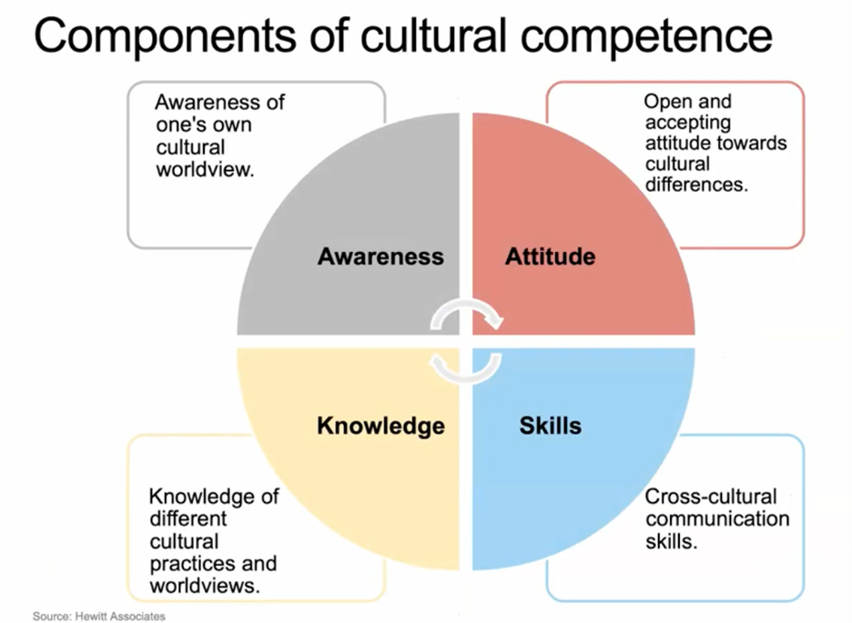
Applying Cross Cultural Competence Concepts to Facilitate Coordination and Achieve Consensus
Ability to quickly and accurately comprehend, and then act effectively and appropriately in a culturally complex environment to achieve the desired effect – without necessarily having exposure to a particular group, region or language.” (Selmeski, 2007)
Assists in recognizing pitfalls and provides skills to control responses in order to achieve an optimal solution for all stakeholders (Pareto Optimal)
End State: "Cultural Interoperability"
Notes:
Diffusion of Innovation Theory: Diffusion of Innovation Theory was first proposed by E.M. Rogers in 1962. It is intended to help explain how a technology or innovation gains momentum and diffuses (or spreads) across various groups within a specific population or social system. However, the characteristics of each designated group outlined in Roger’s Diffusion Theory (i.e.: innovators, early adopters, early majority, late majority, and laggards) are relative as they are largely influenced by the broader industry culture. The instructor can introduce the concept, and then encourage the students to do some critical thinking and articulate how this theory may be applied differently in safety-critical industries. The instructor could introduce the cross-cultural competence concept of “mirror imaging” and demonstrate that the characteristics of “innovator” in one industry could be very different than they are in another industry. The end state, much like the TAM discussion, is that the students gain an appreciation of not just the theory itself, but how it operates and/or is modified across different domains by factors such as culture.

Slide 10
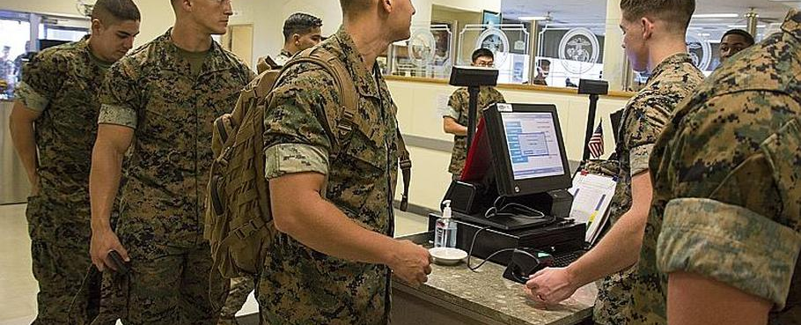
Cross Cultural Competence: Observation
Observation – Interpreting the Cultural landscape
An intentional process to gain awareness. Slow down, look closely and question each component of the scene
Knowing what to look for and how to interpret what you are looking at are key components to observation
Common Pitfalls:
  Mirror imaging – interpreting what you’re seeing through your own cultural lens, background and experience - things you take for granted may not be true here
  Looking without seeing
  Adaptation – ceasing to notice

Slide 11
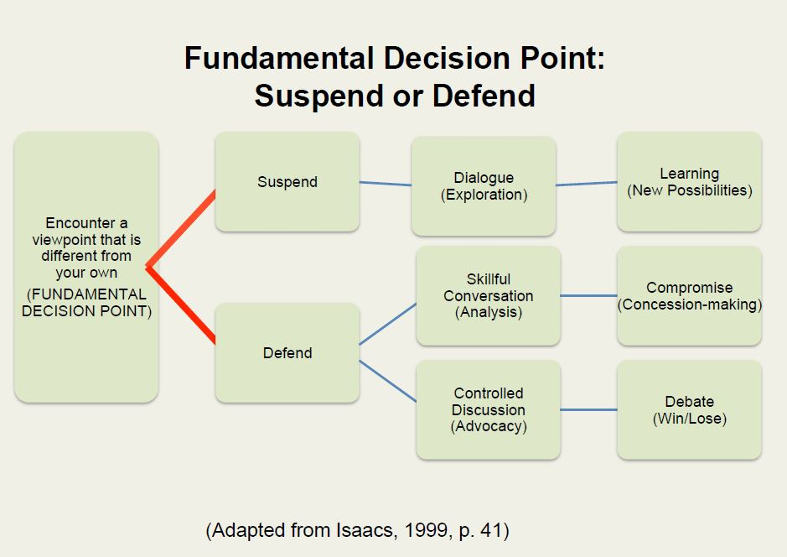
Cross Cultural Competence: Suspending Judgment

Slide 12
References
Hodgson, Amy, “Battle of the Sexes in Game Theory”, YouTube https://www.youtube.com/watch?app=desktop&v=fK1gWMgkCO0
Baronchelli, A., The Emergence of Consensus, A Primer, NIH National Library of Medicine, 21 February 2021. https://www.ncbi.nlm.nih.gov/pmc/articles/PMC5830794/
Lenaerts, Tom, “Game Theory: To Cooperate or not cooperate”, Science and Cocktails, https://www.youtube.com/watch?v=pC4678RC2jI
Shinozaki, K., Wakeyama, T., “A Game Theoretic Analysis Regarding Consensus Building of Geothermal Development in Kyushu Region, Japan”,
Ahlstrom, L., Stag Hunt, Inomics, 13 July 2023, https://inomics.com/terms/stag-hunt-1537413
Penard, T., New Institutional Economics: A Guidebook, Chapter 8, pp.158 – 180, Cambridge University Press, 2008. DOI: https://doi.org/10.1017/CBO9780511754043.011
Notes:
Diffusion of Innovation Theory: Diffusion of Innovation Theory was first proposed by E.M. Rogers in 1962. It is intended to help explain how a technology or innovation gains momentum and diffuses (or spreads) across various groups within a specific population or social system. However, the characteristics of each designated group outlined in Roger’s Diffusion Theory (i.e.: innovators, early adopters, early majority, late majority, and laggards) are relative as they are largely influenced by the broader industry culture. The instructor can introduce the concept, and then encourage the students to do some critical thinking and articulate how this theory may be applied differently in safety-critical industries. The instructor could introduce the cross-cultural competence concept of “mirror imaging” and demonstrate that the characteristics of “innovator” in one industry could be very different than they are in another industry. The end state, much like the TAM discussion, is that the students gain an appreciation of not just the theory itself, but how it operates and/or is modified across different domains by factors such as culture.

