Slide 1

ASTM International Student Chapters
Town Hall (Module #2)
October 30, 2024
Helping Our World Work Better

Slide 2
Objectives
Understand ASTM and standards development as a business
Learn about current strategic objectives and challenges
Learn how new activities are started within ASTM
Explore the member development pipeline and resources available
Notes:
Todays objective is to identify key duties and responsibilities of Main Officers which include the Chair, Vice Chair, Membership Secretary and Secretary in order to strengthen the leadership skills necessary to lead a productive committee.

Slide 3
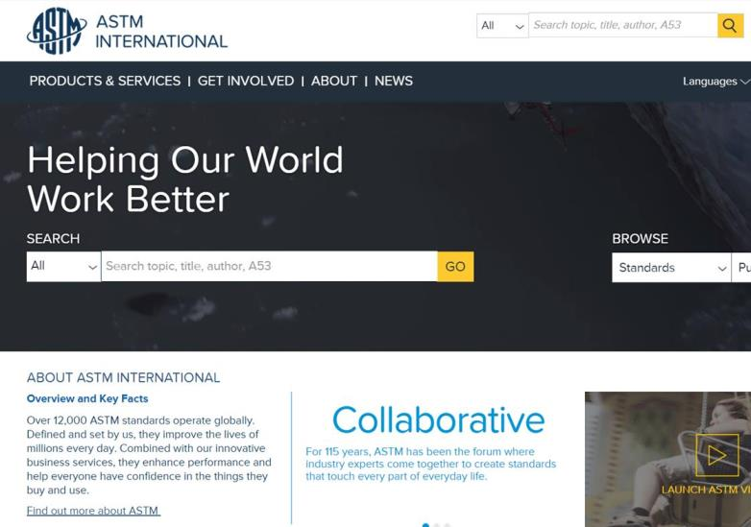
ASTM Background
International Standards Developing Organization (SDO)
Founded in 1898
Non-governmental, not-for-profit organization
Operations funded by sale of published standards along with other publications and services
+12,900 International Standards
+30,000 Members
+140 Technical Committees
90 Industry Sectors

Slide 4

2024 Strategic Objectives

Slide 5

Challenges – Incorporation by Reference (IBR)
What is IBR?
Regulation that incorporates standards by reference: An agency may adopt a voluntary standard, as written, by incorporating the standard in a regulation by listing or referencing the standard by title. This eliminates the cost to the agency required to develop their own standard and provides access to a host of non-government technical experts during the development process.
Regulation based on existing standards: An agency reviews an existing standard and makes changes to match its goal or need.
Agency conducts rulemaking process to solicit public opinion: Public notification and comment period to gather stakeholder feedback. Any final decisions are published in the Federal Register.
Challenge: if the law (and everything referenced therein) is deemed to be free, potential loss of revenue by making all standards IBR free as well. Solution @ present = Reading Room

Slide 6

Challenges – Artificial Intelligence
Tracking committees that are exploring AI or similar technologies in their standards
AI Reading Standards
Interpretation of standards extremely important
AI tool may get info wrong or may “hallucinate”
AI Writing Standards
Current intellectual property rights do not include content developed using AI
AI as a Participating Member
Similar issues: wrong info and IP rights/control
Current ASTM Artificial Intelligence (AI) Policy: ASTM International prohibits the entry of ASTM standards and related intellectual property ("ASTM IP") into any form of AI tools, such as ChatGPT. Creating derivatives of ASTM IP using AI is also prohibited without express written permission from ASTM's President. In the case of such use, ASTM will suspend a licensee's access to ASTM IP, and further legal action will be considered.

Slide 7
Addressing Opportunities/Challenges as New Business
New and emerging areas are intimated like the general standards development process
Stakeholder Driven – comes to ASTM from external sources
3 Stage Process
Exploratory: Post initial request, due diligence, market research
Planning: Live meeting of key stakeholders, education, formal agreement to proceed
Organizational: Live meeting of all interested stakeholders, agreement on title, scope, structure, formal agreement to organize within ASTM International
NOTE: with all proposed new activity, ASTM will always attempt to map the subject matter area(s) to existing ASTM activity prior to contemplating a stand-alone activity. This exercise is part of the Exploratory stage and is to prevent overlapping activity while also taking advantage of existing resources and experience.
The entire process may take anywhere from 6 to 12+ months depending on the complexity, sophistication of existing activity (if any exists), and urgency of need.

Slide 8
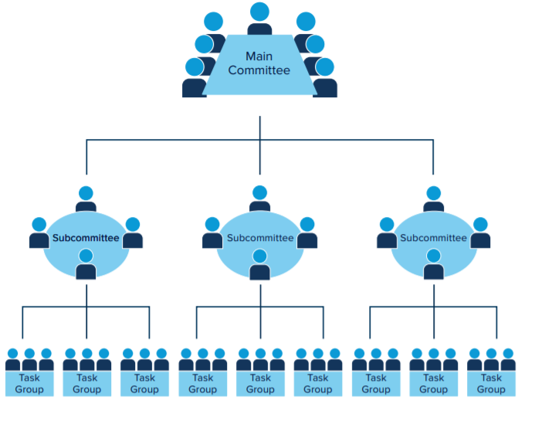
Committee Structure
Main Committee
Each main committee is a semi-autonomous group approved by the ASTM Board of Directors and is responsible for developing standards in a given subject area
Subcommittee
Subs are formed as needed to address specific subjects or areas within the scope of the main committee. These areas include technical as well as administrative functions.
Task Group
Smaller working groups responsible for a specific assignment within a given period of time. Task groups are open to both ASTM members and non-members.

Slide 9
Membership Development
Academic Outreach
Awareness
Student Membership
Early Engagement
Student Chapters
Direct Participation
New Member Orientation
Onboarding
Emerging Professionals
Leadership Development
Virtual Classroom
Basic Member Training
Officers’ Training Workshop
Advanced Member Training

Slide 10
Additional Resources and Opportunities
New and Existing Members
Student Members
Introduction to ASTM Standards
ASTM Regulations/standard development process
Tracking Service
Classroom for Members
Meetings, Symposia and Workshops
How Our Meetings Work
Student membership
Academic Awards (scholarships, grants, etc.)
Chapters Awards
WISE Internship Program

Slide 11
QUESTIONS?
Notes:
Editor/Staff Manager:
Thanks for attending.

Slide 12
Thank you for your attention!
www.astm.org

