Slide 1
Committee E60
Sustainability
www.astm.org

Slide 2
ASTM International and Sustainability
Many ASTM International committees address sustainability: infrastructure/built environment, water, agriculture, energy, products, waste, materials, and toxics (partial list):
C01 on Cement
C09 on Concrete and Concrete Aggregates
C16 on Thermal Insulation
D02 on Petroleum Products and Lubricants
D03 on Gaseous Fuels
D04 on Road and Paving Materials
D05 on Coal and Coke
D18 on Soil and Rock
D19 on Water
D20 on Plastics
D22 on Air Quality
D34 on Waste Management
E06 on Performance of Buildings
E35 on Pesticides and Alternative Control Agents
E44 on Solar, Geothermal and Other Alternative Energy Sources
E47 on Biological Effects and Environmental Fate
E48 on Biotechnology
E50 on Environmental Assessment, Risk Management and Corrective Action
F40 on Declarable Substances in Materials
Notes:
2

Slide 3
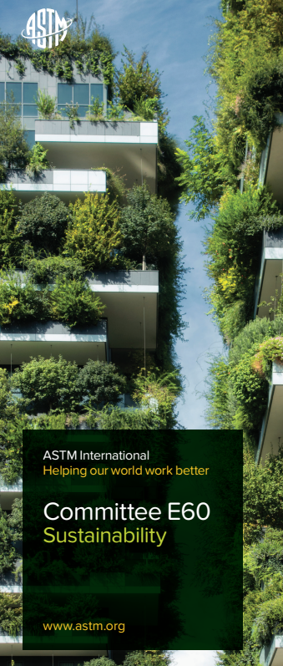
Committee E60 Facts and Figures
3
3
Committee Established October 2008
700+ Members
Technical Subcommittees
E60.01 Buildings and Construction
E60.13 Manufacturing
E60.21 Terminology
E60.42 Sustainable Healthcare
E60.80 General Sustainability Standards
Administrative Subcommittees
E60.90 Executive
E60.91 Strategic Planning
E60.95 Student Liaison/Affairs
Notes:
3

Slide 4
ASTM E60 Sustainability Committee Scope
The development and revision of standards related to sustainability and sustainable development including:
The analysis and assessment of attributes of materials, products, and services and how they contribute to sustainability;
Resilience in the context of preparing for, adapting to, withstanding, and recovering from disruptive events; and
Measurement and description of the impacts of materials, products, and services on the economy, environment, and society

Slide 5
E60 Leadership
Chair: Amy A Costello, Armstrong World Industries, Inc. Vice-Chair: Catherine Houska, Houska Consulting Recording Secretary: Tyler Congleton, Boise Cascade Membership Secretary: Domenic DeCaria, Vinyl Institute
Member-at-Large: Michael Pluimer, University of Minnesota
Member-at-Large: Amanda Forster, NIST Member-at-Large: Christine A Subasic, The Masonry Society
E60.# | Subcommittee Name | Chair | Vice Chair
E60.01 | Buildings & Construction | Dan Figola | John Kurdziel
E60.13 | Sustainable Manufacturing | David Nickelson | KC Morris
E60.21 | Terminology | Deb Callaway | -
E60.42 | Sustainable Healthcare | Millie Calistri Yeh | -
E60.80 | General Sustainability Standards | Margarita Takou | Matthew Hunter
E60.90 | Executive Committee | Amy Costello | Catherine Houska
E60.91 | Strategic Planning | Catherine Houska | -
E60.95 | Student Liaison | John Beakley | -
E60.99 | Honors and Awards | Michael Schmeida | -
ASTM Staff Manager
Kristy Straiton
kstraiton@astm.org

Slide 6
ISO Technical Activity Groups (TAGs)
U.S. TAG to ISO TC 59/SC 17
Sustainability in Buildings and Civil Engineering Works
U.S. TAG to ISO TC 323
Circular Economy
Responsible for 12 published standards, 2 currently in development, several being considered for revision
Most used standard is ISO 21930 on EPDs
Meetings in ASTM E60 week are open to all U.S. visitors
Other participation requires $100 fee for new members to cover expenses
Contact ASTM or martha.vangeem@gmail.com
Six (6) standards under development
Five (5) Working Groups working on technical content; (Terminology, Practical Approaches to CE, Measurement/assessment, CE in practice, Product circularity passports)
High attendance internationally so consensus is challenging
Usually meets once a month
Participation requires a $500 fee for new members to cover expenses
Contact ASTM staff
US TAGs are open to US Residents/citizens only – 1 vote per US TAG reached by consensus

Slide 7
E60 Technical Subcommittees
E60.01 Buildings and Construction
E60.13 Manufacturing
E60.21 Terminology
E60.42 Sustainable Healthcare
E60.80 General Sustainability Standards

Slide 8
E60.01 Buildings and Construction
Standards
E1971 - Standard Guide for Stewardship for the Cleaning of Commercial and Institutional Buildings
E2129 - Standard Practice for Data Collection for Sustainability Assessment of Building Products
E2392/E2392M - Standard Guide for Design of Earthen Wall Building Systems
E2432 - Standard Guide for General Principles of Sustainability Relative to Buildings
E2635 - Standard Practice for Water Conservation in Buildings Through In-Situ Water Reclamation
E2717 - Standard Practice for Estimating the Environmental Load of Residential Wastewater
E2728 - Standard Guide for Water Stewardship in the Design, Construction, and Operation of Buildings
E2843 - Standard Specification for Demonstrating That a Building is in Walkable Proximity to Neighborhood Assets
E2844 - Standard Specification for Demonstrating That a Building’s Location Provides Access to Public Transit
E2921 - Standard Practice for Minimum Criteria for Comparing Whole Building Life Cycle Assessments for Use with Building Codes, Standards, and Rating Systems
E3073 - Standard Guide for Development of Waste Management Plan for Construction, Deconstruction, or Demolition Projects
E3182 - Standard Practice for Preparing an Occupant Exposure Screening Report (OESR) for Substances in Installed Building Products
Notes:
Since 2008, ASTM Committee E60 on Sustainability has developed technically sound, market-relevant standards that promote sustainability and sustainable development. Standards for the built environment come from Subcommittee E60.01 on Buildings and Construction. E60.01 established common language on sustainability in building performance
E2432 on general principles of sustainability, which defines three areas — environmental, economic and social — and the core approaches to decision making used in pursuing sustainability.

Slide 9
E60 Subcommittees
E60.80 General Sustainability
E60.21 Terminology
E2727- Standard Practice for Assessment of Rainwater Quality
E3027 - Standard Guide for Making Sustainability-Related Chemical Selection Decisions in the Life-Cycle of Products
E3199 - Standard Guide for Alternative Allocation Approaches to Modeling Input and Output Flows of Secondary Materials and Related Recycling Scenarios in Life Cycle Assessment
E3341-22 - Standard Guide for General Principles of Resilience
AC309, E60.80.06, Sustainability Database
E2114-23 Standard Terminology for Sustainability

Slide 10
E60 Subcommittees
E60.13 Sustainable Manufacturing
NEW- E60.42 Sustainable Healthcare
E2979 - Classification for Discarded Materials from Manufacturing Facilities and Associated Support Facilities
E2986 - Guide for Evaluation of Environmental Aspects of Sustainability of Manufacturing Processes
E2987 - Terminology for Sustainable Manufacturing
E3012 - Guide for Characterizing Environmental Aspects of Manufacturing Processes
E3096 - Guide for Definition, Selection, and Organization of KPI for Environmental Aspects of Manufacturing Processes
E3200 - Investment Analysis in Environmentally Sustainable Manufacturing
E3014 - Standard Practice for Managing Sustainability in Dentistry

Slide 11
E60 Standards under Development
E60.01 Building and Construction
WK49400 - New Practice for The Development of Multi-Attribute Sustainability Standards for Building Products
E60.13 Sustainability Manufacturing
E60.42 Sustainable Healthcare
WK88241 - Managing Sustainability in Dentistry with regards to Dental Facilities, Equipment and Consumables
WK88282 – Designing for Recyclability of Single-Use Medical Products and Packaging
E60.80 – General Sustainability
WK71997- Resilience-Based Design of Culverts Exposed to Flood Events
WK77797 - Resilience-Based Design of Culverts Exposed to Wildfire Events
WK90489 - GHG Credit Standards
WK88302 - Risk Assessment of the Effects of Climate Change and Extreme Weather Events on Buried Drainage Structures
WK90102 - Minimum Criteria for Comparing Materials and Systems During Built Environment Use Stage Life Cycle Assessments
WK90146 - Standard Practice for Preparing an Environmental and Human Exposure Screening Report (ESR) for Substances Used in the Built Environment
WK88294 - Constant Voltage AC Analogue for Systems and Equipment in Alternating Current Electric Vehicle Charging
WK84168 - Sustainable Agricultural Practices
WK83603 * Standard Guide for Principles of Circular Product Design

Slide 12
E60 Sustainability Database

Slide 13
E60 Workshop Reports
Circular Economy
Decarbonization
Circular Textiles
This report and the types of standards it proposes will be of particular interest to material and product designers, manufacturing processors, recovery processors (including those in the resale, repair, repurpose, refurbish, remanufacture, and recycling sectors), as well as system planners and policymakers. These stakeholders will also be critical for realizing these CE standards. ASTM Subcommittee E60 is initiating new efforts to address some of the standards needs and welcome other experts in the field to join and expand upon existing development activities and initiate new ones.
This report summarizes the outcomes from the workshop and is valuable to those applying LCA to improve their organization’s sustainability practices. Sustainability managers and practitioners will find a collection of existing standards and best practices for using LCA tools, data repositories, methods for allocating environmental impact to products, and problems that exist in using them, particularly for decarbonization efforts
This report describes the key discussions and findings of the workshop and highlights areas where specific standards needs were identified. It concludes with recommendations for the next steps and a proposed roadmap to begin developing the identified standards to enable circular textiles
Notes:
Or break them out into 3 below slides 16-18

Slide 14
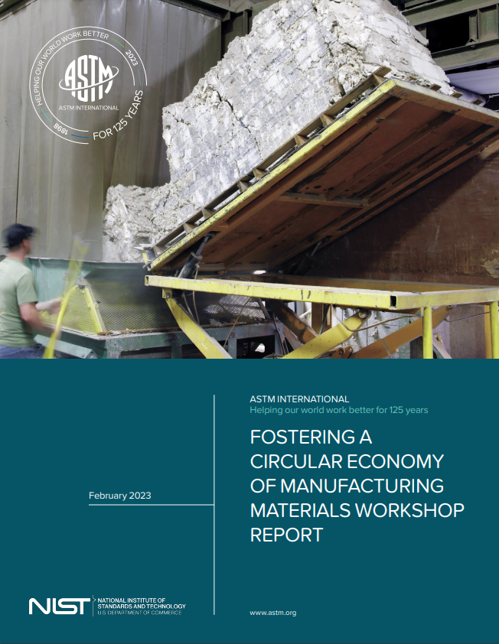
Notes:
This report and the types of standards it proposes will be of particular interest to material and product designers, manufacturing processors, recovery processors (including those in the resale, repair, repurpose, refurbish, remanufacture, and recycling sectors), as well as system planners and policymakers. These stakeholders will also be critical for realizing these CE standards. ASTM Subcommittee E60 is initiating new efforts to address some of the standards needs and welcome other experts in the field to join and expand upon existing development activities and initiate new ones.

Slide 15
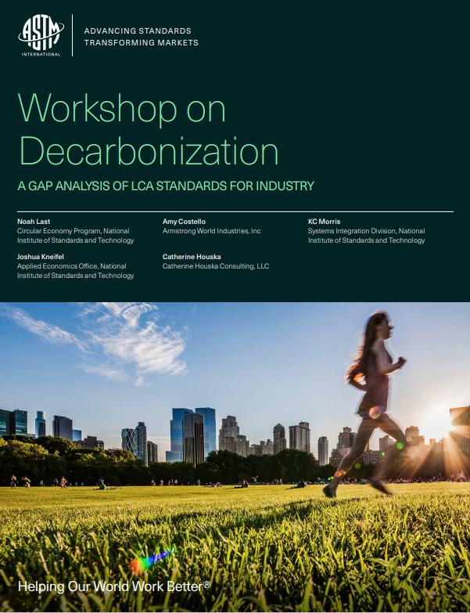
Notes:
This report summarizes key outcomes from the Workshop on Decarbonization: A Gap Analysis of LCA Standards for Industry, an event organized by ASTM International in conjunction with NIST. The workshop aimed to identify and map gaps in international standards related to industrial decarbonization and this report summarizes those findings.
Individuals applying LCA to improve their organization's sustainability practices, standards development organizations (SDOs), and other standards professionals to inform future planning will find value in this report. Readers will discover key gaps in the field of LCA, along with recommendations for addressing these challenges, to help with the development of new standards or revisions of existing ones.

Slide 16
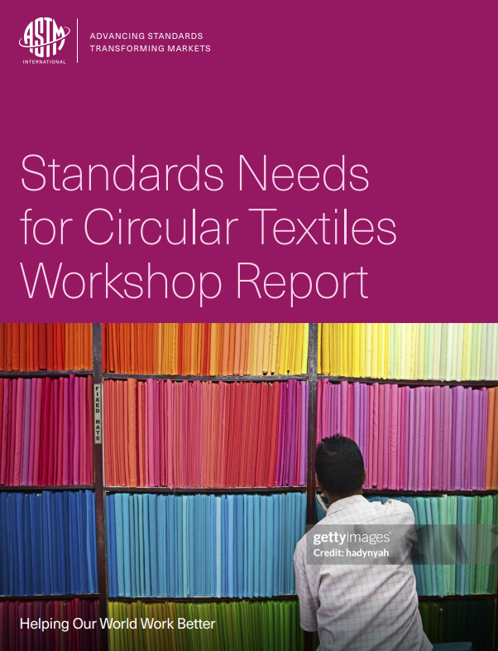
Coming November 2024..
Notes:
Coming Nov 2024
This report describes the key discussions and findings of the workshop and highlights areas where specific standards needs were identified. It concludes with recommendations for the next steps and a proposed roadmap to begin developing the identified standards to enable circular textiles

Slide 17
Thank you

