Slide 1
ASTM UMV Autonomy and Control Sub-Committee F41.01
Chair: Lora Weiss, Georgia Tech Research Institute
Vice-Chair: Lou Larkin, Lockheed Martin
17 August 2011

Slide 2
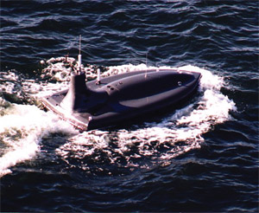

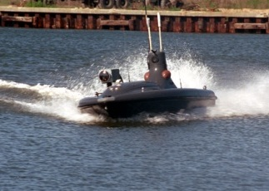

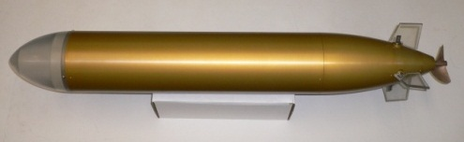
Autonomy & Control UMV Standard
Motivation
Identified Need for UMVs to operate
autonomously & collaboratively
without constant human intervention
with flexibility based on payloads and missions
UMV community is expected to expand both its developer base and its user base
Success relies upon well-written standards
Standards must encourage
compatibility, re-configurability, and interoperability
provide a common language to describe functional capabilities
enable meaningful quantitative performance evaluation

Slide 3
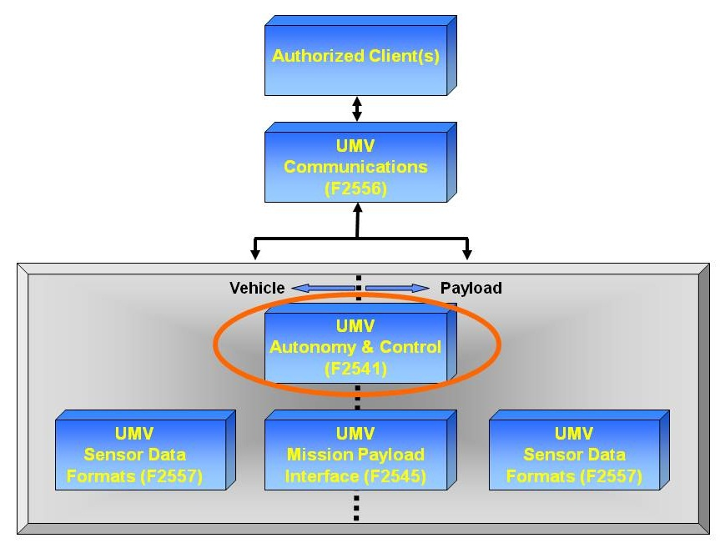
Autonomy & Control UMV Standard
OBJECTIVES
Support Decision Process for Acquisition and Development of Non-specific UMV Systems
Balance
Procurement Needs of Industry
Exploratory Freedom of Research Community
Provide documents that Define Today’s Products and Focus on Tomorrow’s Technologies
SCOPE
Provide UMV Autonomy & Control Standard
When Implemented, Results in a UMV Capable of Operating for Extended Periods of Time Without External Intervention
Include Terminology
Autonomy & Control Described Within The Context of a Common Language
Define Functional Capabilities
Index Autonomy Capabilities According to:
Situational Awareness, Decision-Making, Planning and Control, and External Interactions
Provide a Level of Autonomy (LOA) Measurement for Each of These
STATUS
Autonomy and Control Standard has Been Published
F2541 – Standard Guide for Autonomy and Control for Unmanned Undersea Vehicles
Periodic Sub-Committee Meetings
Address Comments on Existing Standard
Assign Actions to Further Develop Sections of the Standard
Need to Refine, Update, and Evolve the Standard

Slide 4
Unmanned Systems - Major Functional Categories (Autonomy-Centric Decomposition)
FAMILIES OF SYSTEMS
Mission-Level Specs Collaborative Sensing
Mission-Level Metrics Collaborative Planning
Mission-Level Performance Collaborative Missions
PAYLOADS & WEAPONS
AUTONOMY
VEHICLE
Situation Awareness & Assessment
Data Fusion
Common Relevant Operating Picture
Task Evaluation & Reporting
Obstacle/Collision Avoidance
Task / Asset Allocation Interoperability, & Deconfliction
Collaborative & Cooperative Control
Mission / Route /Sensor / Weapon Planning
Mission Safeties, Objectives, Constraints
Off-board Authorization
Survivability
Vehicle Safeties & Reliability
Navigation
Guidance & Control
Propulsion & Maneuvering
On-board Processors
Launch & Recovery
Quick React
Payload Safeties
Payload & Fault Mgmt
Payload Sensors & Proc.
Payload Launch & Recovery
Weapon Launch & Recovery
Weapon Lethality
UxV INFRASTRUCTURE SERVICES
Data Recording, Communications, System Health Monitoring, Operator Interfaces
Data Links, incl. BLOS and incl. Vehicle Health Command and Control & C4ISR
& Data Interfaces Net-Centric Ops. Infrastructure Safeties Comms Mgmt
& Fault Mgmt

Slide 5
UMV Functional Decomposition
Unmanned System
Payload Services
Autonomous Sortie Services
Vehicle Services
Payload Safeties & Fault Management
Situation Analysis
Mission Objectives and Constraints
Payload & Vehicle Management
Navigation
Payload Management (sensor & weapon)
Data Fusion
Task Allocation and Sequencing
Mission Oriented Safeties & Fault Management
Guidance & Control
Sensor Processing
Common Relevant Operating Picture
Route Planning
Offboard
Authorization
Propulsion & Maneuvering
Launch & Recovery
Task Evaluation and Reporting
Sensor and Weapons Planning
UMV Visibility
Quick React
Infrastructure Services (Operations)
Data Recording
Infrastructure Safeties & Fault Management
Prognostic Health Assessment (vehicle component oriented)
Comms Interface (int & ext)
Comms Management
(includes comms planning as a service)
Energy

Slide 6

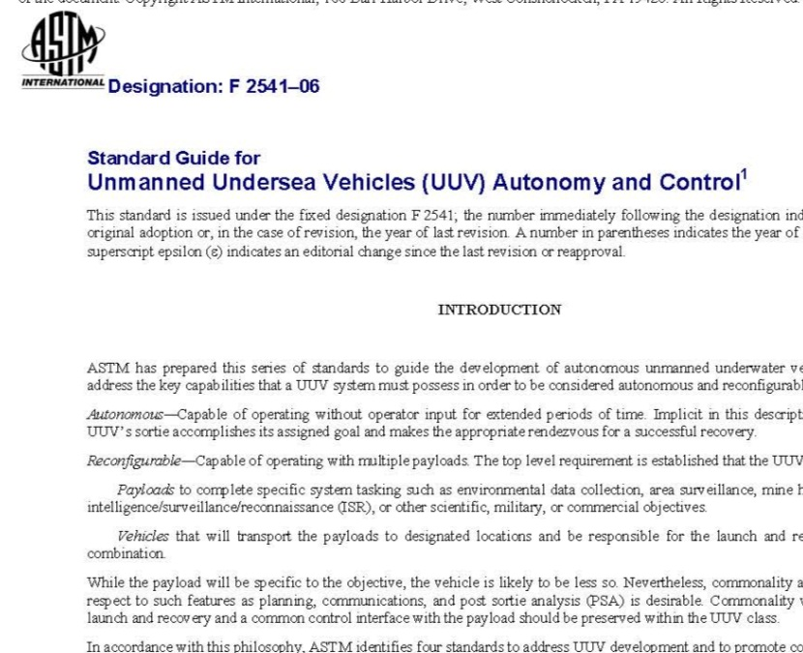
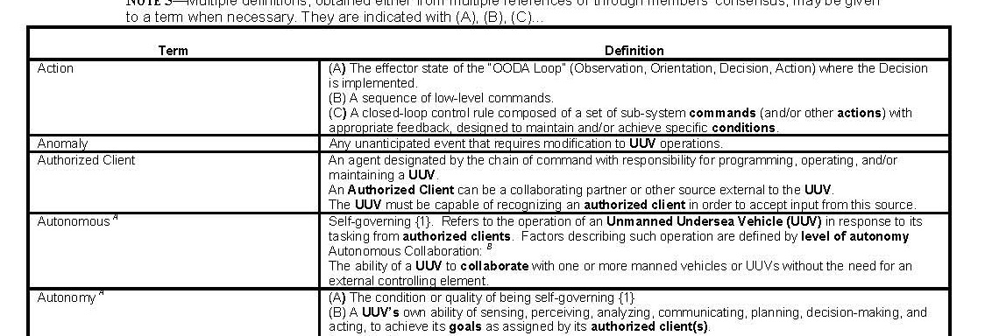
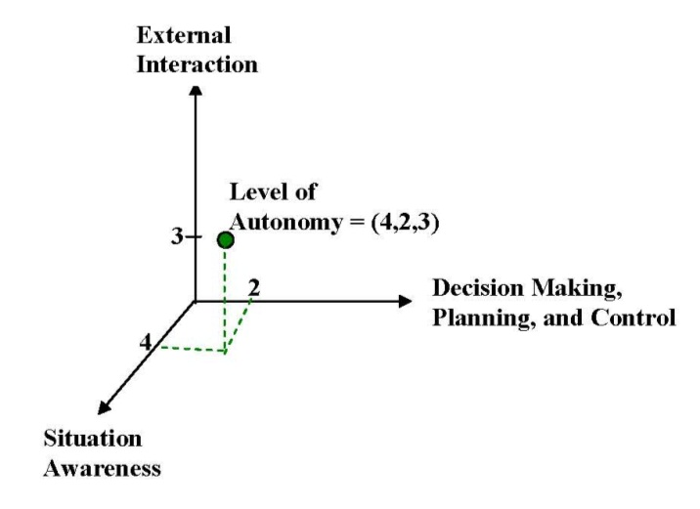
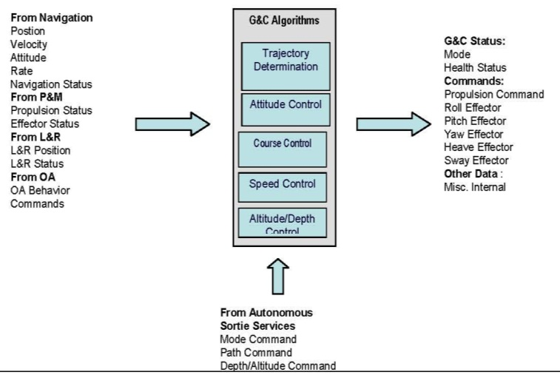
Autonomy & Control UMV Standard
(selected content)
UMV Terminology*
Autonomy & Control Standard
UMV Levels of Autonomy*
Guidance & Control Interface (in draft)
*based off of NIST, but adapted for UMVs

Slide 7
Summary
Autonomy and Control Standard has Been Published
F2541: Standard Guide for Autonomy and Control for Unmanned Undersea Vehicles
Periodic Sub-Committee Meetings Held (need to re-engage)
Address Comments on Existing Standard
Assign Actions to Further Develop Sections of the Standard
Refine, Update, and Evolve the Standard
All Volunteers Willing to Work on Content Are Welcome
Contact
Lora Weiss Lora.Weiss@gtri.gatech.edu
or Lou Larkin louis.j.larkin@lmco.com

