Slide 1
T0TEM – T0 Test Evaluation Module
National Aeronautics and Space Administration
ASTM Committee Week 11/6/2018
ASTM E08.07.06 – E1921
Levi Shelton
Cameron Bosley
www.nasa.gov

Slide 2
Topics
Status
Software Overview
Testing Results
Planned Additions
Working Group Distribution

Slide 3
Status
Basic functionality complete:
  Standard T0 calculation (multi-temp and single temp methods)
  Master Curve plotting and selectable confidence bounds
  Bi-modal and multi-modal calculations and plots
  US and SI unit selectable
  Manual entry/file select input
  Margin adjustment
Work still being done on:
  Output Files
  Input File formatting

Slide 4
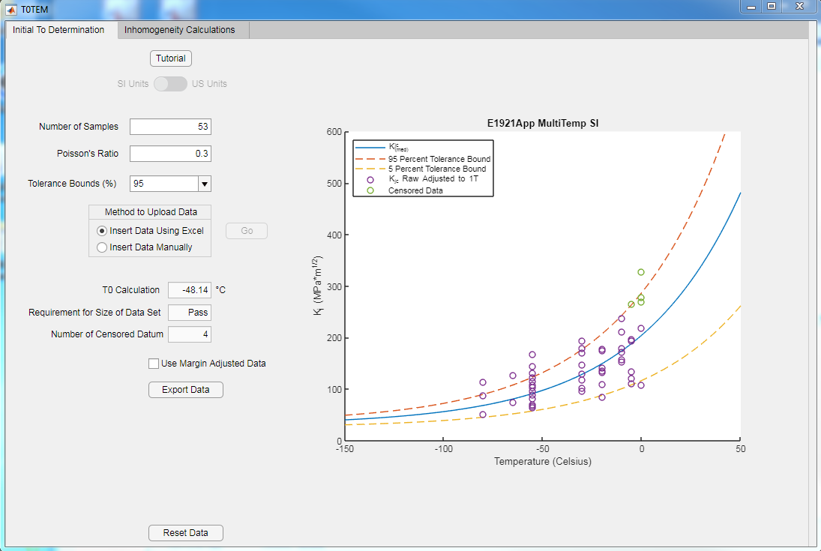
Software Overview

Slide 5
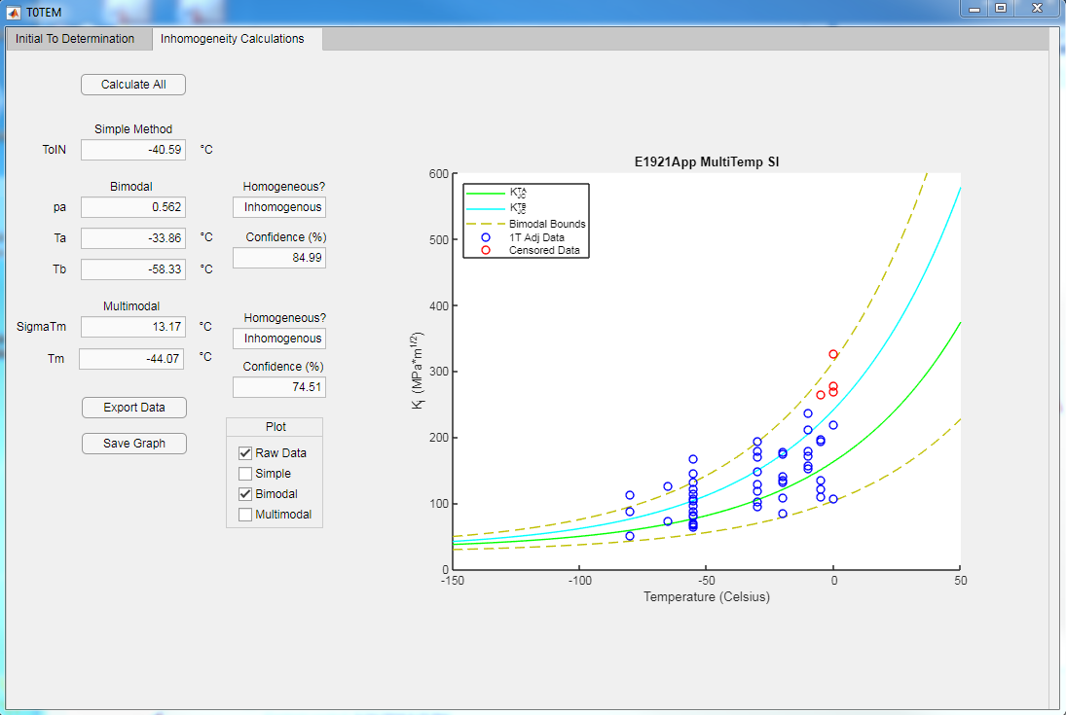
Software Overview

Slide 6
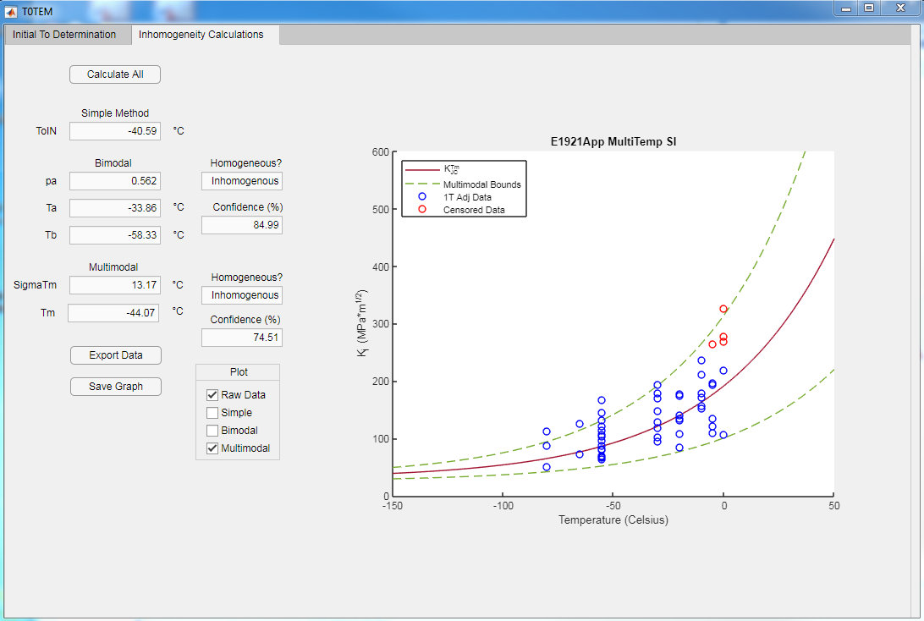
Software Overview

Slide 7
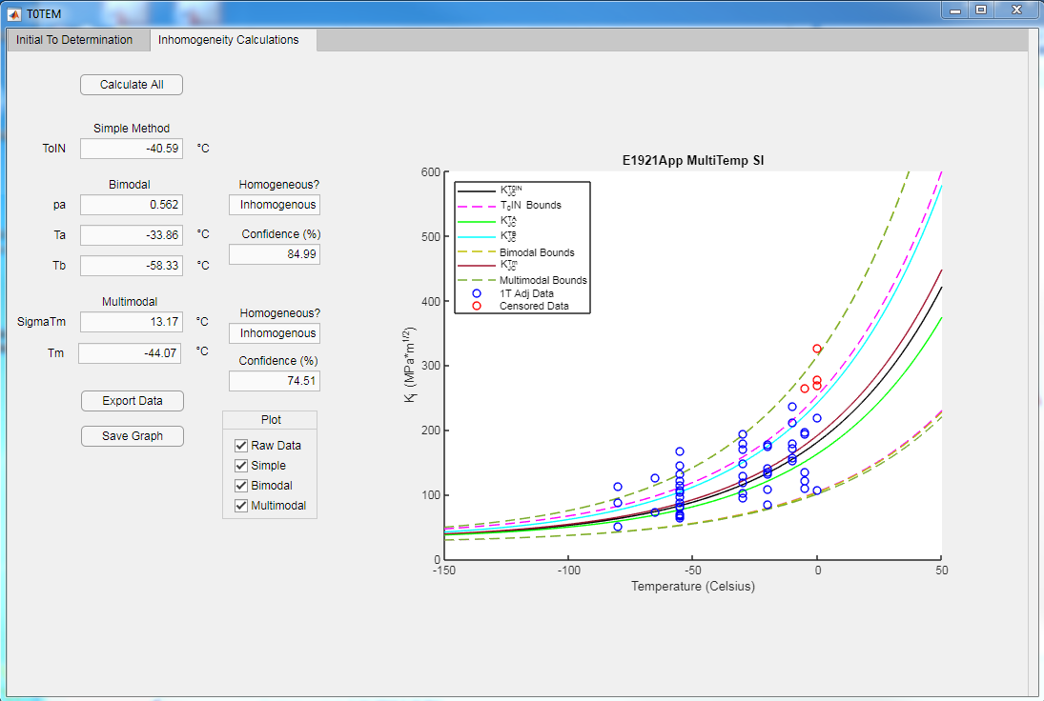
Software Overview

Slide 8
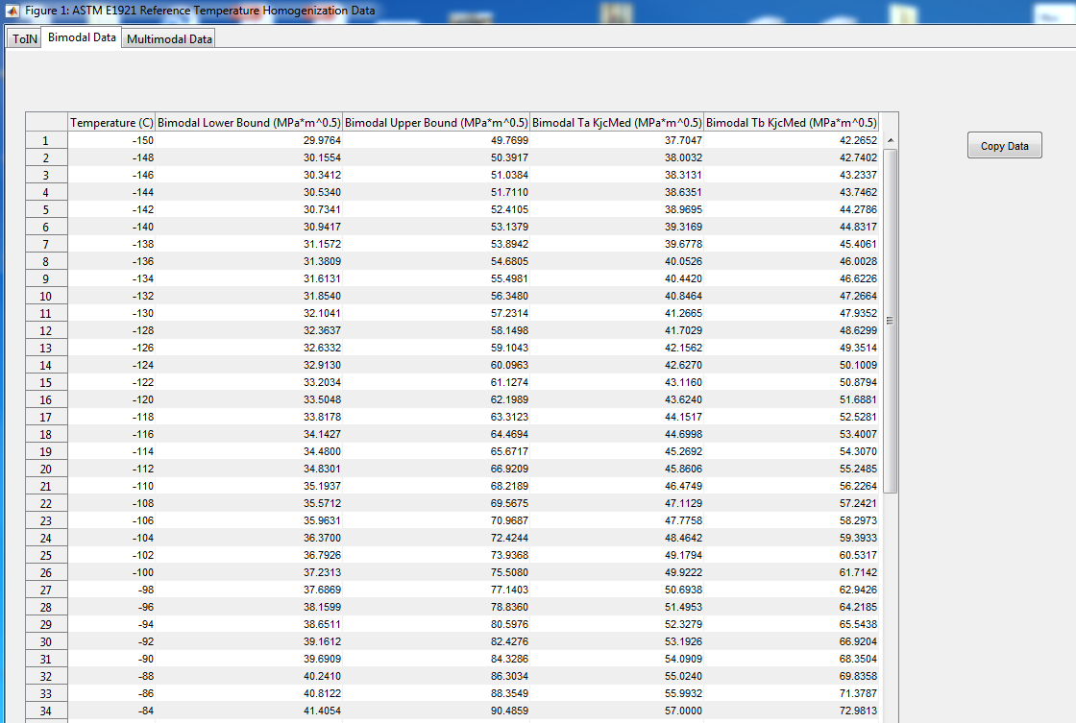
Software Overview

Slide 9
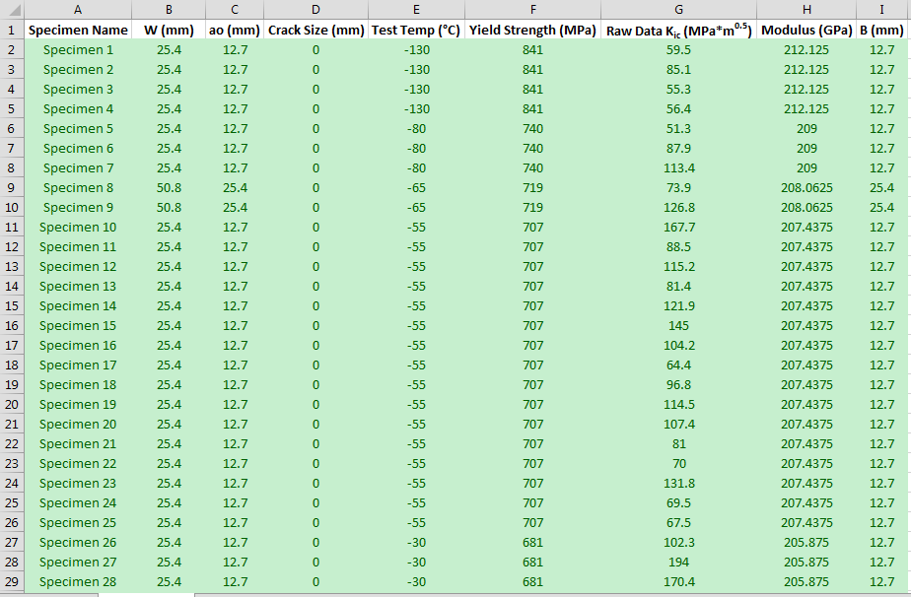
Software Overview

Slide 10
Testing Results
For E1921 example problem:
  Time to calculate standard T0 <5s
  Time to calculate inhomogeneity results <5s
  T0TEM has non-significant differences (<0.3%) from standard results

Slide 11
Testing Results: Bi-Modal
 |  |  |  |  |  |  |  |  |  | Absolute Diff |  | Percent Diff
 |  | Standard |  |  |  | T0TEM |  |  |  | T0TEM/Standard |  | T0TEM/Standard
T_{i} – T_{o} | T_{i} | K_{A}(T) | K_{B}(T) | K_{Jc(0.05)} | K_{Jc(0.95)} | K_{A}(T) | K_{B}(T) | K_{Jc(0.05)} | K_{Jc(0.95)} | K_{Jc(0.05)} | K_{Jc(0.95)} | K_{Jc(0.05)} | K_{Jc(0.95)}
(ºC) | (ºC) | (MPa√m) | (MPa√m) | (MPa√m) | (MPa√m) | (MPa√m) | (MPa√m) | (MPa√m) | (MPa√m) | (MPa√m) | (MPa√m) | (MPa√m) | (MPa√m)
-50 | -98 | 53.6 | 67.1 | 37.7 | 77.1 | 53.6 | 67.1 | 37.7 | 77.1 | -0.01 | 0.04 | -0.03 | 0.05
-45 | -93 | 55.9 | 70.7 | 38.9 | 81.5 | 55.9 | 70.7 | 38.9 | 81.5 | 0.00 | 0.00 | 0.01 | 0.00
-40 | -88 | 58.4 | 74.6 | 40.2 | 86.3 | 58.4 | 74.6 | 40.2 | 86.3 | 0.04 | 0.00 | 0.10 | 0.00
-35 | -83 | 61.1 | 79 | 41.7 | 91.6 | 61.1 | 79.0 | 41.7 | 91.6 | 0.01 | -0.02 | 0.03 | -0.02
-30 | -78 | 64.1 | 83.7 | 43.3 | 97.4 | 64.1 | 83.8 | 43.3 | 97.4 | 0.03 | -0.01 | 0.06 | -0.01
-25 | -73 | 67.4 | 89 | 45.1 | 103.8 | 67.4 | 89.0 | 45.1 | 103.8 | 0.00 | -0.03 | 0.00 | -0.03
-20 | -68 | 71.1 | 94.8 | 47.1 | 110.8 | 71.1 | 94.8 | 47.1 | 110.8 | -0.05 | -0.01 | -0.10 | -0.01
-15 | -63 | 75.1 | 101.2 | 49.2 | 118.5 | 75.1 | 101.2 | 49.2 | 118.5 | 0.00 | 0.01 | -0.01 | 0.01
-10 | -58 | 79.4 | 108.2 | 51.6 | 127 | 79.5 | 108.2 | 51.6 | 127.0 | -0.04 | 0.01 | -0.09 | 0.00
-5 | -53 | 84.3 | 115.8 | 54.1 | 136.3 | 84.3 | 115.9 | 54.1 | 136.3 | 0.05 | 0.04 | 0.09 | 0.03
0 | -48 | 89.6 | 124.3 | 57 | 146.6 | 89.6 | 124.3 | 57.0 | 146.6 | 0.00 | 0.01 | 0.00 | 0.01
5 | -43 | 95.4 | 133.6 | 60.1 | 157.9 | 95.4 | 133.6 | 60.1 | 157.9 | 0.03 | 0.00 | 0.05 | 0.00
10 | -38 | 101.9 | 143.8 | 63.6 | 170.3 | 101.9 | 143.8 | 63.6 | 170.3 | -0.02 | 0.02 | -0.04 | 0.01
15 | -33 | 108.9 | 155.1 | 67.4 | 184 | 108.9 | 155.1 | 67.4 | 184.0 | -0.04 | -0.03 | -0.05 | -0.01
20 | -28 | 116.7 | 167.5 | 71.5 | 199 | 116.7 | 167.5 | 71.5 | 199.0 | 0.03 | -0.01 | 0.04 | 0.00
25 | -23 | 125.2 | 181.1 | 76.1 | 215.5 | 125.3 | 181.1 | 76.1 | 215.5 | 0.01 | 0.00 | 0.01 | 0.00
30 | -18 | 134.6 | 196 | 81.1 | 233.7 | 134.7 | 196.0 | 81.1 | 233.7 | 0.05 | -0.04 | 0.06 | -0.02
35 | -13 | 145 | 212.5 | 86.7 | 253.6 | 145.0 | 212.5 | 86.7 | 253.6 | -0.02 | 0.03 | -0.02 | 0.01
40 | -8 | 156.3 | 230.6 | 92.8 | 275.6 | 156.4 | 230.6 | 92.8 | 275.6 | -0.03 | -0.02 | -0.03 | -0.01
45 | -3 | 168.8 | 250.4 | 99.5 | 299.7 | 168.9 | 250.5 | 99.5 | 299.7 | -0.03 | 0.03 | -0.03 | 0.01
50 | 2 | 182.6 | 272.3 | 106.8 | 326.3 | 182.6 | 272.3 | 106.8 | 326.3 | 0.03 | -0.02 | 0.03 | -0.01

Slide 12
Testing Results: Multi-Modal
 |  |  |  |  |  |  |  | Percent Diff
 |  | Standard |  |  | T0TEM |  |  | T0TEM/Standard
T_{i} – T_{m} | T_{i} | K_{Jc(0.50)} | K_{Jc(0.05)} | K_{Jc(0.95)} | K_{Jc(0.50)} | K_{Jc(0.05)} | K_{Jc(0.95)} | K_{Jc(0.50)} | K_{Jc(0.05)} | K_{Jc(0.95)}
(ºC) | (ºC) | (MPa√m) | (MPa√m) | (MPa√m) | (MPa√m) | (MPa√m) | (MPa√m) | (MPa√m) | (MPa√m) | (MPa√m)
-51 | -95 | 56.24 | 38.11 | 79.50 | 56.24 | 38.11 | 79.50 | 0.00 | 0.01 | 0.01
-46 | -90 | 58.83 | 39.35 | 84.09 | 58.83 | 39.35 | 84.10 | -0.01 | -0.01 | 0.01
-41 | -85 | 61.69 | 40.72 | 89.16 | 61.69 | 40.72 | 89.16 | 0.01 | 0.00 | 0.01
-36 | -80 | 64.82 | 42.23 | 94.72 | 64.83 | 42.23 | 94.72 | 0.01 | 0.01 | 0.00
-31 | -75 | 68.27 | 43.88 | 100.85 | 68.28 | 43.88 | 100.85 | 0.01 | 0.01 | 0.00
-26 | -70 | 72.07 | 45.69 | 107.58 | 72.07 | 45.69 | 107.58 | 0.00 | 0.00 | 0.00
-21 | -65 | 76.24 | 47.68 | 114.99 | 76.24 | 47.68 | 115.00 | 0.00 | -0.01 | 0.01
-16 | -60 | 80.83 | 49.87 | 123.15 | 80.83 | 49.88 | 123.15 | 0.00 | 0.01 | 0.00
-11 | -55 | 85.87 | 52.28 | 132.11 | 85.87 | 52.28 | 132.11 | 0.00 | 0.00 | 0.00
-6 | -50 | 91.42 | 54.93 | 141.97 | 91.42 | 54.93 | 141.97 | 0.00 | 0.01 | 0.00
-1 | -45 | 97.52 | 57.83 | 152.82 | 97.52 | 57.83 | 152.82 | 0.00 | 0.00 | 0.00
4 | -40 | 104.23 | 61.03 | 164.74 | 104.23 | 61.03 | 164.74 | 0.00 | 0.00 | 0.00
9 | -35 | 111.60 | 64.54 | 177.86 | 111.61 | 64.54 | 177.86 | 0.01 | 0.00 | 0.00
14 | -30 | 119.71 | 68.40 | 192.28 | 119.72 | 68.40 | 192.29 | 0.00 | 0.00 | 0.00
19 | -25 | 128.64 | 72.64 | 208.15 | 128.64 | 72.65 | 208.15 | 0.00 | 0.01 | 0.00
24 | -20 | 138.44 | 77.31 | 225.59 | 138.45 | 77.31 | 225.60 | 0.00 | 0.00 | 0.00
29 | -15 | 149.23 | 82.44 | 244.78 | 149.24 | 82.44 | 244.78 | 0.01 | 0.00 | 0.00
34 | -10 | 161.09 | 88.08 | 265.88 | 161.10 | 88.08 | 265.88 | 0.00 | 0.00 | 0.00
39 | -5 | 174.14 | 94.28 | 289.08 | 174.14 | 94.29 | 289.08 | 0.00 | 0.01 | 0.00
44 | 0 | 188.48 | 101.10 | 314.59 | 188.49 | 101.11 | 314.60 | 0.00 | 0.01 | 0.00

Slide 13
Planned Additions
Allow for active adjustment of plot area
Simple upper shelf plotting ability
Add list of where specimens fall into validity requirements (to help adjust temperature while testing still being conducted)
Tutorial auto runs ASTM sample set
Output of Kjc▲a and Kjc limit values
Compressing code into functions for ease of troubleshooting and operation speed
Combining standard T0 and Inhomogeneity plots

Slide 14
Beta Testing
Following the NASA process for releasing programs. As part of that process we will provide a targeted intergovernmental release to select individuals to allow for beta testing that will ultimately be used to support a wider release.
In short term if anyone has non-sensitive/normalized data they are willing to share or would like analyzed we can send the input format file and return results for comparison.

Slide 15
SignOffPage
Notes:
NASA Presentation Sign-Off Page

Slide 16
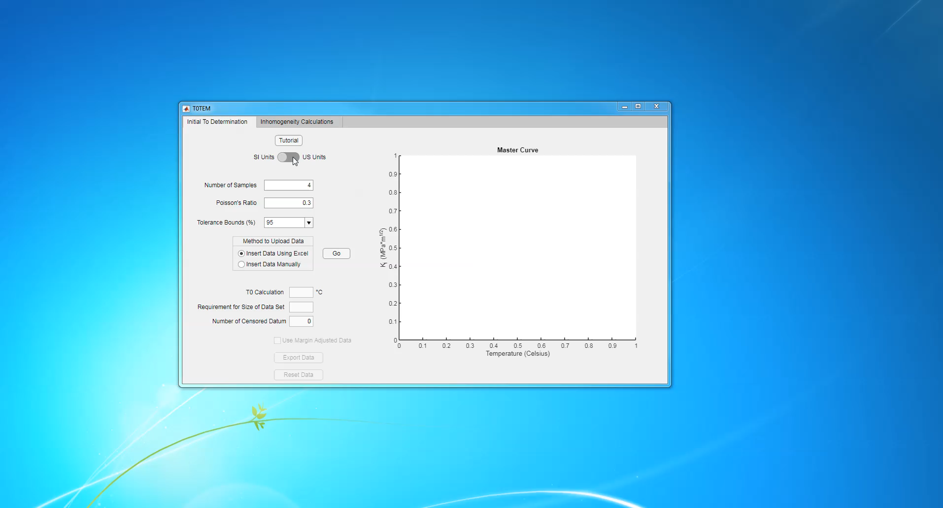
Demonstration

