Slide 1


Standards Development at ASTM International
Learning Module Series
Notes:
Welcome to ASTM International. This learning module provides an informative overview of ASTM’s voluntary consensus standards development process. For over 125 years, ASTM International has served as an expert and unifying resource for the timely development of high-quality, market-relevant standards. In this module, you’ll learn about the fundamental principles of the ASTM consensus process and how ASTM standards are developed and delivered to the marketplace.

Slide 2
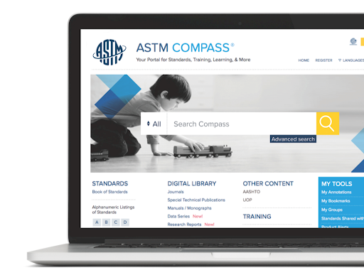
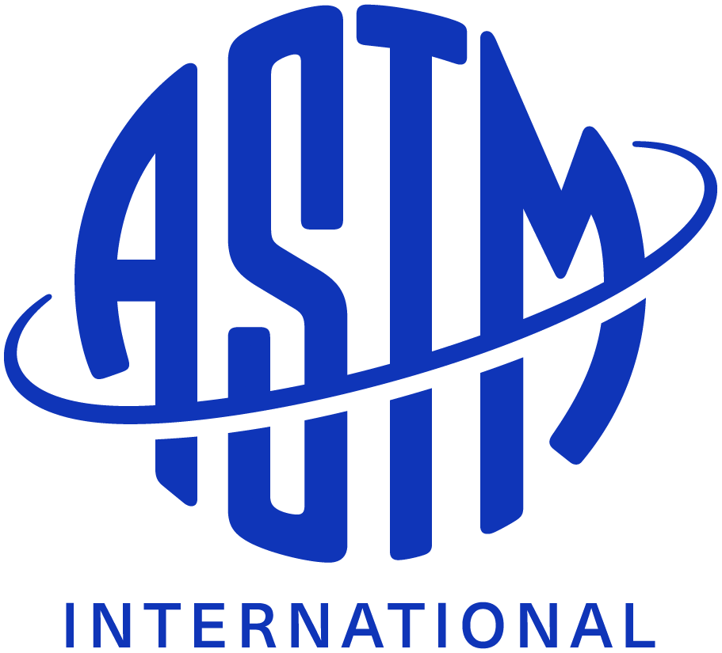
What is an ASTM Standard?
Developed within the consensus principles of ASTM
ASTM Standards fuel global trade, promote health and general welfare, advance innovation
Product specifications, test methods, practices, guides, classifications and terminology
©2025 Proprietary and Confidential. All Rights Reserved.
Notes:
As used in ASTM International, a standard is a document that has been developed and established within the consensus principles of the organization and which meet the requirements of ASTM procedures and regulations. Full consensus standards are developed with the participation of all parties who have a stake in the standards’ development or use. ASTM standards fuel global trade in international markets, create a healthier and safer world for people everywhere, and drive innovation in products and services. They are used by individuals, companies and agencies around the world. Types of standards developed at ASTM might include product specifications, test methods, practices, guides, classifications, and terminology.Did you know that ASTM’s first standard was issued in 1901 and was focused on improving the quality and reliability of steel in the growing railroad industry?

Slide 3


ASTM Members
World's top scientist, engineers, business leaders
Represent international stakeholder group
Serve on more than 145 technical standards writing committees across broad range of fields
©2025 Proprietary and Confidential. All Rights Reserved.
Notes:
ASTM standards are developed by the world’s top scientists, engineers and business leaders. ASTM’s members represent producers, users, consumers, governments, and academia from around the world, who work in a collaborative and consensus process to develop technical documents that are a basis for manufacturing, management, procurement, codes, and regulations. These members serve on one or more of ASTM's 145 technical standards writing committees covering fields such as petroleum, consumer products, aviation, building construction, the environment, metals, and much more.

Slide 4

ASTM Process
Open and Transparent
Membership and participation is open to any interested individual or organization, anywhere in the world
Essential information is easily and equally available to all
©2025 Proprietary and Confidential. All Rights Reserved.
Notes:
To best understand the ASTM International standards development process, it is important to first appreciate the guiding principles that make the process unique. First, the ASTM process is built on the concept of openness – meaning that membership on and participation in ASTM standards writing committees is open to any individual or organization with an interest in an activity. The ASTM process is also transparent – all essential information related to the development of standards is easily and equally available to any individual or organization in real time, breaking down the barriers of time and place.

Slide 5

The Process
Equal Voice, Equal Vote
All stakeholders have an equal voice
Fair and balanced voting process
Widespread acceptance of ASTM standards
©2025 Proprietary and Confidential. All Rights Reserved.
Notes:
Further distinguishing the ASTM standards development process is its fair and balanced voting process. Simply stated, at ASTM International, all members have an equal vote and equal voice in the development of technical standards. Fairness is further ensured through balanced participation among producers, users and general interest members of an ASTM standards writing committee. Openness, transparency and a balanced, consensus process are the hallmarks of the ASTM system and have contributed to the quality, integrity and worldwide acceptance of ASTM standards for over 125 years.

Slide 6

Participation
Standards Without Boundaries
More than 150 countries represented in ASTM International membership
Effectively serve the global markets they represent
©2025 Proprietary and Confidential. All Rights Reserved.
Notes:
Direct participation, flexibility and responsiveness have also attracted a diverse range of global stakeholders to ASTM. More than 150 countries are represented in ASTM International’s broad membership. Working in a consensus process that is blind to national boundaries, ASTM members deliver standards that truly connect to the international markets they serve.Did you know that ASTM Committee D02 on Petroleum Products and Lubricants has more than 68 countries represented in its membership?

Slide 7

From an Idea....to a Standard
Starting the Process:
members identify the need
Outside Stakeholders contact ASTM
ASTM provides the forum for consensus and collaboration
©2025 Proprietary and Confidential. All Rights Reserved.
Notes:
New standardization activities at ASTM International are started in one of two ways: an existing task group or subcommittee identifies the need for a new standard or external representatives approach ASTM with an idea for a standard. In the latter case, when industry stakeholders come to ASTM for assistance, ASTM staff will research whether there is an existing standard through contact with trade associations, government agencies or other standards development organizations. If other stakeholders agree to the need for a standard, a new activity is established in the form of a new task group within an existing technical subcommittee, or, if needed, the formation of a new subcommittee or committee. Once approval to proceed with the creation of a new standard is given by the subcommittee, a work item is registered and draft development begins.In recent years, the advent of new technologies and businesses, and social and political change have resulted in a dynamic new range of standards activities at ASTM. Today stakeholders in exciting fields such as nanotechnology, homeland security, underwater vehicle systems, biotechnology and others are doing their standards development work under the ASTM International umbrella.

Slide 8
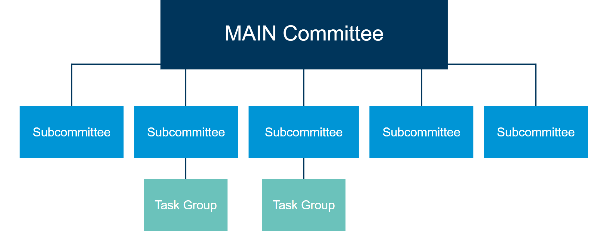
Creating New Standards
©2025 Proprietary and Confidential. All Rights Reserved.
Notes:
Understanding the structure within ASTM’s technical committees is integral to appreciating the value of the ASTM standards development and approval process. The hierarchy comprises three basic levels: main committees, subcommittees, and task groups. Task groups perform most of the research and writing that form the basis of draft standards. ASTM provides various tools and guides, including draft standard templates and Form and Style Manual, to assist standards writers in the process. All tools are available electronically from the ASTM website for ease of use.

Slide 9

Work Item Registration System
Adds further efficiency and transparency to ASTM process
Track draft standards and revisions before and during balloting
Encourage further open, global participation
©2025 Proprietary and Confidential. All Rights Reserved.
Notes:
Adding further efficiency and transparency to the standards development process, ASTM’s Work Item Registration system allows users to register and track draft standards and revisions before and during the balloting stage. Any interested individual from anywhere in the world who wants to know whether ASTM is developing or revising a standard in a particular area can access the information using the Work Item Registration system.

Slide 10
Balloting and Review Process
Subcommittee approval followed by full membership review
Balloting process ensures fairness and balanced participation
Leads to high quality. market relevant standards
©2025 Proprietary and Confidential. All Rights Reserved.
Notes:
When task group members have completed the draft of the new standard, it is reviewed by its parent subcommittee. After the subcommittee approves the document, it is submitted to the main committee and the entire membership of ASTM International for review and voting – this is referred to as the balloting process. The standard must gain subcommittee, main committee, and Society approval before becoming an official ASTM standard.The balloting process is one of the most critical components of the ASTM standards development system. It is where fairness and balanced participation is ultimately ensured. Each ASTM member is given the opportunity to share his or her expertise with those on the committee or subcommittee. Voting guidelines are included with every ballot to provide information regarding the different ways to cast a vote. Through the balloting process the document is molded into a technically sound, market relevant standard that is capable of meeting stakeholders’ goals and serving the needs of the marketplace.

Slide 11

Handling Negative Votes
All negative votes must be fully considered
Final approval of standard contingent on due process and proper procedures
All Votes Considered
©2025 Proprietary and Confidential. All Rights Reserved.
Notes:
All negative votes cast during the balloting process, which must include a written explanation of the voters’ objections, must be fully considered before the document can be submitted to the next level in the process. Final approval of a standard depends on concurrence by an ASTM Standing Committee, the Committee on Standards (COS), which ensures proper procedures were followed and due process was achieved.In 2005, ASTM launched a new web distribution system for balloting negatives and comments. The system makes it possible for committee members and subcommittee chairmen to view comments and negative votes in real time to their own portal on the ASTM website. This allows faster communication related to resolution of negative votes.

Slide 12

Timely Standards Development
Consensus process can take as little time as six months
ASTM technologies speed standards to the marketplace
Global participation right from the desktop
©2025 Proprietary and Confidential. All Rights Reserved.
Notes:
Depending on the development and approval process, standards can take as little as six months to become full consensus standards. ASTM continues to invest in powerful technologies that support the needs of its global members, enabling them to get new high-quality, relevant standards into the marketplace as quickly as possible.

Slide 13

Virtual Meetings
Combines teleconferencing with online document viewing
Brings global members together more easily, reduces standards development time
©2025 Proprietary and Confidential. All Rights Reserved.
Notes:
A powerful tool in the ASTM standards development process is virtual meeting technology, which combines teleconferencing with online document viewing and editing. Many ASTM technical committees have embraced virtual meeting technology, also known as web conferencing, to share information more effectively, bring members together more easily, and reduce the time needed to develop and approve consensus standards.Did you know that ASTM’s virtual meeting capabilities enabled Committee F37 on Light Sport Aircraft to streamline the consensus process and deliver over 20 new standards in less than two years? These standards are now referenced by the Federal Aviation Administration, as well as government agencies in other nations worldwide.

Slide 14
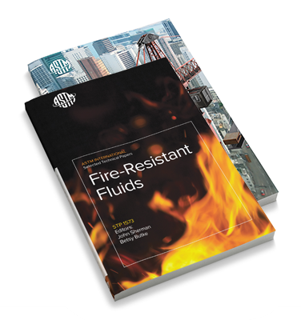
Serving the Global Marketplace
Annual Book of ASTM Standards
Online search and purchase of ASTM standards
Specialized publications, journals, manuals, and monographs
©2025 Proprietary and Confidential. All Rights Reserved.
Notes:
Once a new standard has successfully been approved through the consensus process, it is assigned a fixed alphanumeric designation and receives an official approval date. More than 12,900 ASTM standards are available in the 86-volume Annual Book of ASTM standards – available in print, or as a virtual volume – or as individual downloads from the ASTM website. Through convenient online search capabilities, users can find specific ASTM standards by keyword or standard numbers and also see the titles and scopes of all documents referenced in each standard. ASTM also facilitates the generation and dissemination of technical standards information through various specialized publications such as journals, manuals and monographs on specific topics.

Slide 15
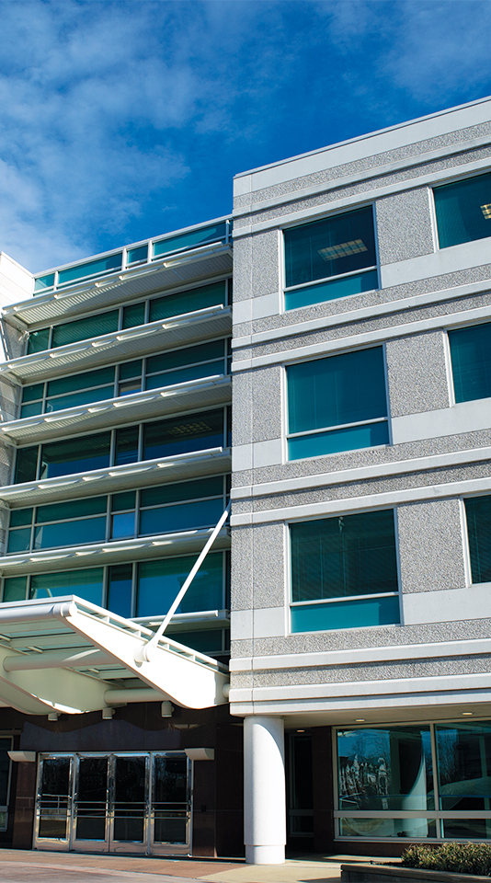
Thank you
Learning Module Series
Notes:
We hope that this module has helped you to better understand the renowned consensus standards development system at ASTM International. To learn more about ASTM standards and how they are used to impact global trade and improve health safety and security, please view our other learning modules or visit the ASTM website at www.astm.org.For further information, please contact:Ileane SmithManager, Member Promotion and Academic Outreach 610-832-9552ismith@astm.org

