Slide 1
Module 1: Strategic Integration of Consensus Standards to Facilitate Technology Adoption and Diffusion
Joseph Sinicrope
Research Scientist, FIU Applied Research Center
Chair, Committee on Technical Committee Operations
Vice Chair, E10 Committee on Nuclear Technology and Applications
Chair, E10.03 Committee on Decommissioning of Nuclear Facilities and Components

Slide 2
The Vision: Leverage the ASTM Student Chapters as a delivery platform for advanced standards curriculum
Academic Outreach
Awareness
Student Membership
Early Engagement
Student Chapters
Direct Participation
New Member Orientation
Onboarding
Emerging Professionals
Leadership Development
Virtual Classroom
Basic Member Training
Officers’ Training Workshop
Advanced Member Training
Addresses gaps in standards education
There is an abundance of Standards 101 / Standards Mechanics curriculum, but a dearth of advanced standards curriculum that highlights the theoretical underpinnings
Intent was to add value by developing curriculum that provides a deeper understanding of why standards work
Enhances the ROI of the ASTM Student Chapter Initiative
Unique opportunity to address the higher-level demand from a cadre of students who self-selected to gain a deeper understanding of standards
18 x graduate students and 4 x ASTM Emerging Professionals

Slide 3

Advanced Standards Curriculum
FALL SEMESTER
Module 4
Module 5
Module 6
Virtual participation in ASTM E10.03 Subcommittee Mtg (Adjudicating Ballot Results)
Role Play Exercise: Understanding Stakeholder Equities in the Standards Development Process
Course Review and Parting Thoughts
Oct
Nov
Dec
Module 1
Module 2
Module 3
Strategic Integration of Consensus Standards to Facilitate Technology Acceptance and Diffusion
Standards as Soft Regulation in an Era of Rapid Expansion of Emerging Technologies
Game Theory and Cross Cultural Competence Applications to Voluntary Consensus Standards
Jan
Feb
Mar
SPRING SEMESTER

Slide 4
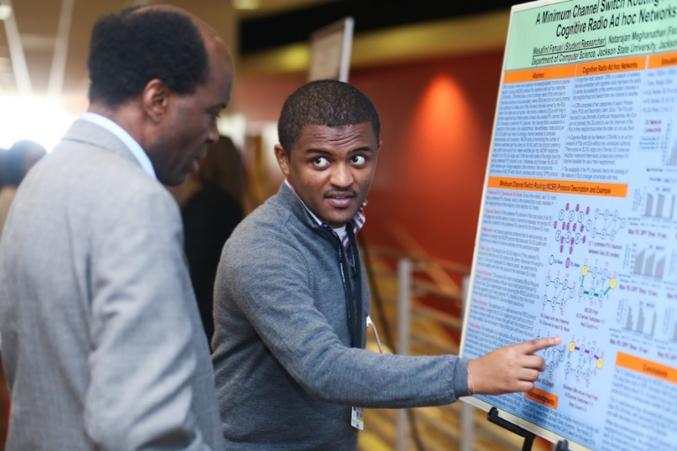
Key Learning Outcomes
At the end of this module, you will be able to:
Demonstrate an awareness of external factors that impact technology acceptance and diffusion
Core technologies as part of an Innovation Ecosystem
Technology Acceptance Models and the roles of trust, uncertainty, and perceived risk
Identify the potential impacts of Information Asymmetry on technology selection and how minimum quality standards can mitigate them
Be able to explain how voluntary consensus standards address stakeholder equities to facilitate technology selection and diffusion

Slide 5
Scene Setter: Which One Would You Select?
•Choose between the two fixative technologies based on the given information:
•Technology 1: Incombustible fixative intended to maintain stabilization of residual radioactive material when exposed to fire contingency scenarios outlined in safety basis documents. $0.75 / square foot. Met ASTM E84, NFPA 701, and UL723 standards.
•Technology 2: Incombustible fixative intended to maintain stabilization of residual radioactive material when exposed to fire contingency scenarios outlined in safety basis documents. $0.75 / square foot.
•Choose between the two fixative technologies based on the given information:
•Technology 1: Incombustible fixative intended to stabilize residual radioactive material when exposed to fire contingency scenarios outlined in safety basis documents. $1.00 / square foot. Met ASTM E84, NFPA 701, and UL723 standards.
•Technology 2: Incombustible fixative intended to stabilize residual radioactive material when exposed to fire contingency scenarios outlined in safety basis documents. $0.75 / square foot.
Thought for Consideration: The use of standards intuitively influences one’s technology selection, BUT WHY?
Notes:
1) Simulate taking the survey with 21 students for each scenario; 2) Get responses for “why” students selected the technology with associated standards – more information? Trust it more? Appears less risky?

Slide 6
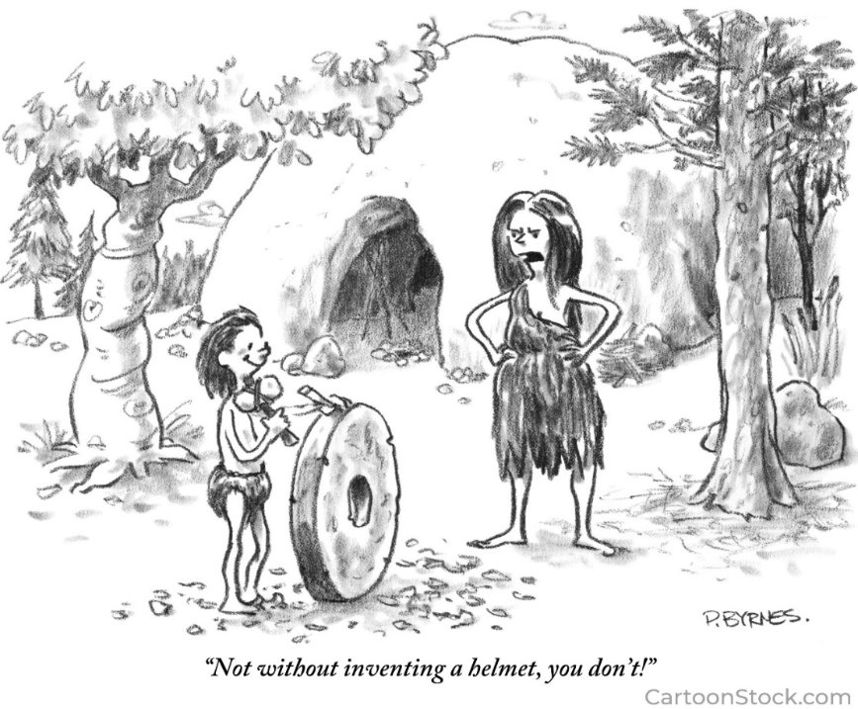
External Factors / Critical enablers (e.g.: helmet) can be as important as the core technology (e.g.: wheel)

Slide 7
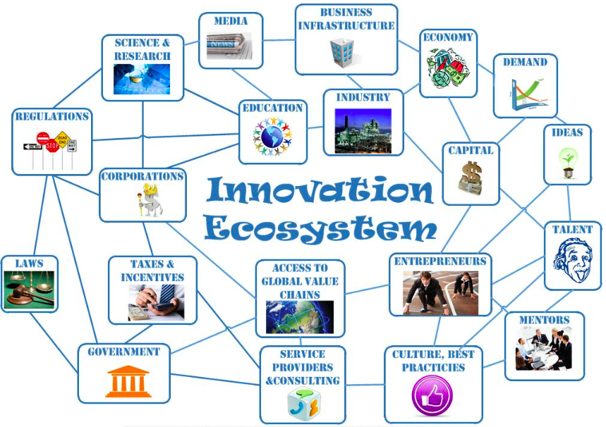
Assess the Innovation Ecosystem and its Impacts and Develop a Comprehensive Strategy
STANDARDS

Slide 8
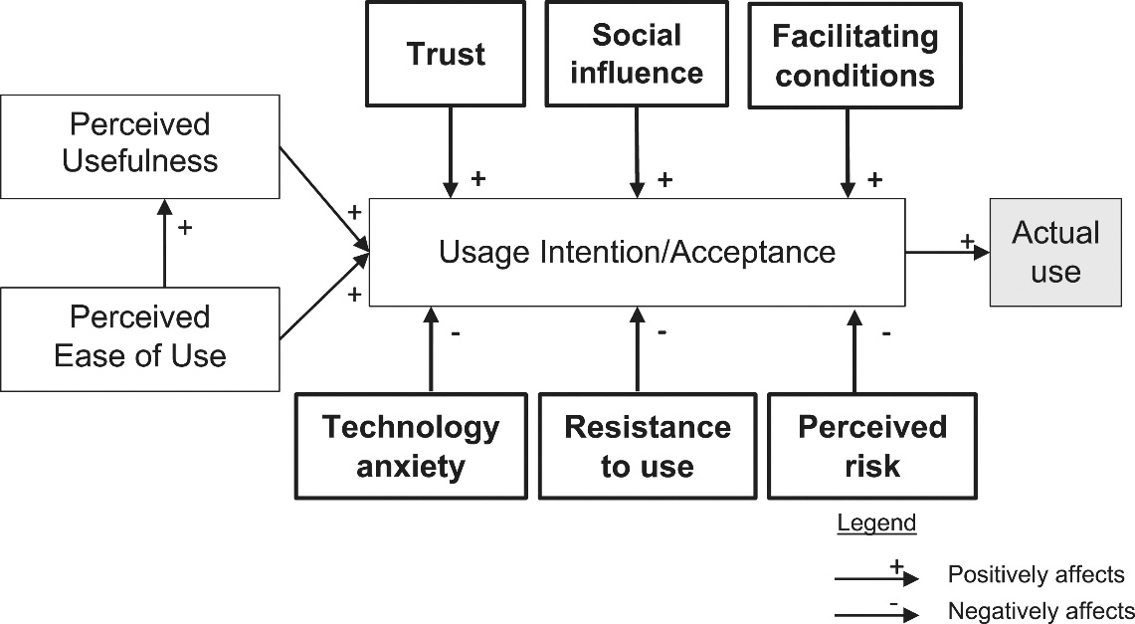
Technology Acceptance Models (TAM) and the Role of Uncertainty, Perceived Risk, and Trust
TAMs predict why individuals adopt or resist new technologies by assessing their perceptions of the technology's perceived usefulness and perceived ease of use
Helps in identifying adoption barriers and developing strategies to promote technology adoption
Mayer’s Integrated Model of Organizational Trust (cited over 30K times), Lee and See’s model of Trust in Automated Systems (cited over 3K times), Hoff and Bashir’s Trust in Advanced Systems model (cited over 1000 times)
Provide empirical data that an end user’s trust framework and risk threshold play a critical role in their decision to accept and use a technology / product

Slide 9
Information Asymmetry and Negative Impacts on Trust, Uncertainty, and Perceived Risk
Information Asymmetry
George Akerlof (Nobel Laureate), “The Market for Lemons: Quality Uncertainty and Impacts on Market Mechanisms”
Imbalance in information among stakeholders increases the exchange risk and can create market failures related to technology acceptance and diffusion
Voluntary consensus standards close the knowledge gap (increase transparency) by communicating critical information related to quality, performance, and safety (e.g.: Met ASTM E84, NFPA 701, and UL723 standards)

Slide 10
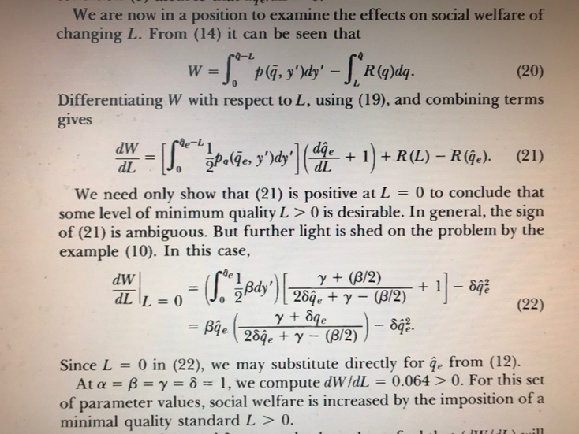
A Theory of Minimum Quality Standards - H.E. Leland
Researched the impacts of minimum quality standards on mitigating Akerlof’s concept of information asymmetry
Empirically demonstrated the positive impacts of minimum quality standards and licensing in reducing market failures caused by information asymmetry
Other key findings:
Social welfare is increased by the imposition of a minimal quality standard
Minimal quality standards are particularly advantageous in highly risk averse industries
Leland’s mathematical confirmation of positive effects of minimum quality

Slide 11
Standards as Trust Constructs and Impacts on Technology Selection and Adoption
What factor weighed most heavily in your adoption of the new technology?
Trust Constructs Sample Mean
Similarity between the new and old 0.227
technology
Met Industry standards 0.372
Standards referenced in 0.429
regulations
Return Policy 0.145
Warranty 0.362
Bahmanziari et al, 2016

Slide 12
Voluntary Consensus Standards Address Stakeholder Equities
-Establishes technology performance requirements
-Supports compliance oversight
-Aligns w/Public Law / Code
-Public Law 104-113
-OMB Circular A-119,“Federal Participation in the Development and Use of Voluntary Consensus Standards
Policy Makers and Regulators
End Users
-Reduces risk
-Instills confidence and trust
-Improves analysis, comparison, and decision making in technology selection
Producers, Manufacturers, and R&D Funding Agencies
-Clearly defines performance parameters
-Standardizes quality assurance and testing
-Promotes a common understanding
-Increases ROI on private sector / federally-funded R&D investments
Public
-Significantly improves trust and confidence
-Promotes common understanding
-Enhances public safety and good stewardship
Notes:
Relatively self-explanatory.

Slide 13
References and Reading Material
Integrating Transparency, Trust, and Acceptance: The Intelligent Systems Technology Acceptance Model (ISTAM), E. S. Vorm, David J. Y. Combs, pages 1828-1845 | Received 01 Apr 2021, Accepted 18 Apr 2022, Published online: 20 May 2022
World Trade Organization, 2011. Decisions and Recommendations Adopted by The WTO Committee on Technical Barriers to Trade since 1 January 1995.
Saunders, F. C., Gale, A. W., & Sherry, A. H. (2013). Understanding project uncertainty in safety-critical industries. Paper presented at PMI® Global Congress 2013—EMEA, Istanbul, Turkey. Newtown Square, PA: Project Management Institute.
Gupta, A.K., Lad, L.J., 1983. Industry self-regulation: an economic, organizational, and political analysis. Academy of Management Journal, Rev. 8, 416–425.
GAO report, DOE’s Program to Develop New Technologies for Environmental Cleanup, Statement by Victor S. Rezendes, Director, Energy, Resources, and Science Issues, Resources, Community, and Economic Development Division, May 1997.
Akerlof, G.A., 1970. The market for lemons: quality uncertainty and the market mechanism. The Quarterly Journal of Economics, MIT Press, 488–500.
Leland, H. E., 1979. Quacks, lemons, and licensing: A theory of minimum quality standards; The Journal of Political Economy 87(6):1328–1346.
Blind, K., Petersen, S. Riillo, C.., “The impact of standards and regulation on innovation in uncertain markets.”, Research Policy, 2017.
Tassey, G., 1999. Standardization in Technology-Based Markets, Research Policy
Standards, Conformity Assessment, and Trade: Into the 21st Century. Washington, DC: The National Academies Press. https://doi.org/10.17226/4921.
Bahmanziari, T., Pearson, J., Crosby, L., “Technology Adoption? A Policy Capturing Approach”, Pages 46-54 | Published online: 01 Feb 2016
Sinicrope, J., Komninakis, M., Nicholson, J., “Strategic Integration of Consensus Standards to Improve Technology Acceptance and Return on Investment in Federally-funded Applied R&D Programs for Safety-critical Industries”, WM2021 Conference, Phoenix, AZ.
Davis, F. D. (1989), "Perceived usefulness, perceived ease of use, and user acceptance of information technology", MIS Quarterly, 13 (3): 319–340.
Bachmann, R. (2022). Trust and Institutions. In: Poff, D.C., Michalos, A.C. (eds) Encyclopedia of Business and Professional Ethics. Springer, Cham. https://doi.org/10.1007/978-3-319-23514-1_1109-1cience, 35 (8): 982–1003, doi:10.1287/mnsc.35.8.982, S2CID 14580473

Slide 14
Joseph Sinicrope, jsinicro@fiu.edu, 571-235-1282

Slide 15
How much would you pay?

