Slide 1


ASTM Standards and You: The Role of Standards in our Everyday Lives
Learning Module Series
Notes:
Welcome to ASTM International. Each and every day, ASTM standards are all around us – protecting public health and safety, facilitating a cleaner environment, improving product quality, advancing the growth of new technologies, supporting global trade, and countless other critical uses. This learning module provides a perspective on the importance of ASTM standards by examining the role they play in our daily lives.

Slide 2


ASTM Standards...
More than Meets the Eye!
Enhance health, safety and quality of life
Facilitate global trade and market access
Support product reliability and quality
Reduce costs, improve supplier relations
Guide business communications and marketing
Advance innovation and new technologies
Support regulatory goals and compliance
Transfer technology to the marketplace
©2025 Proprietary and Confidential. All Rights Reserved.
Notes:
If you thought standards are just highly technical engineering documents, you might want to take another look. ASTM International standards impact our world in more ways than you can imagine.ASTM standards enhance our lives by promoting health, safety and security in numerous ways. They are the engine of global commerce, guiding business communications and forming the basis for the free flow of trade. Architects and designers use them in their plans to build high quality, reliable products. They are used in laboratories by scientists and engineers working on the advancement of new technologies and by companies to enhance their manufacturing processes and supply chain relationships.Purchasers and sellers incorporate ASTM International standards into contracts; governments in North America, South America, Europe, Asia, Africa, the Middle East and other parts of the world reference them in codes, regulations, and laws; and many others refer to them for guidance in strategic decision making. Let’s take an even closer look at the ways ASTM standards are around us every day.

Slide 3


Water Quality
Asbestos Monitoring
Environmental Site Assessment
Drinking water is tested
for harmful bacteria and other elements using ASTM standards
ASTM test methods and practices help to monitor asbestos in the indoor environment
ASTM standards
facilitate environmental site assessments in compliance with U.S. Environmental Protection Agency regulations
©2025 Proprietary and Confidential. All Rights Reserved.
Notes:
While many aspects of ASTM standards affect our daily lives, they have significant impact in the area of environmental health and safety. The contribution of ASTM standards can be felt in areas like cleaner air and water, improved waste management and recycling, safer wildlife, and environmentally friendly homes, facilities and buildings. Today, for example, approximately 1000 ASTM environmentally-related standards have been developed thanks to the efforts of various technical committees related to the environment. Notable among these are ASTM standards that help identify harmful bacteria in drinking water; test methods and practices for monitoring asbestos in the indoor environment; and standards that facilitate environmental site assessments in compliance with U.S. Environmental Protection Agency regulations.Did you know that cleaner air is also made possible by ASTM standards for biodiesel, an alternative fuel that helps reduce serious air pollutants?

Slide 4
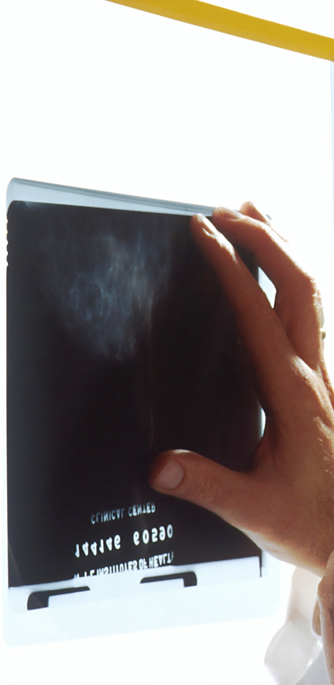
Health and Medical Care
Health Information:
Continuity of Care Record defines a core set of information in the healthcare setting
Hearing Aids:
ASTM standards are assisting in the development and performance of implantable hearing device technology
©2025 Proprietary and Confidential. All Rights Reserved.
Notes:
Another important contribution of ASTM standards is in the area of health and medical care. In today’s healthcare environment, quality information is an essential component of thorough and effective medical care. For example, helping doctors and other healthcare practitioners to better preserve and transfer patient information is the focus of a newly released ASTM standard called the Continuity of Care Record. This standard defines a core set of information to be sent to the next healthcare provider whenever a patient is referred, transferred or uses different medical facilities or providers. ASTM standards are also at work helping the millions of people living with hearing loss. Here you will find ASTM standards assisting in the development and performance of implantable hearing device technology.

Slide 5

Sports and Recreation
Safety Helmets:
ASTM safety helmet standards are used in sports such as bicycling, roller skating, soccer, horseback riding and martial arts
Snow Skiing:
ASTM standards provide guidance on proper performance of the ski-boot-binding system
©2025 Proprietary and Confidential. All Rights Reserved.
Notes:
If you enjoy various sports and recreational activities you may be glad to learn that ASTM standards play a valuable role in improving the quality of the equipment and facilities we use in these pursuits. A popular area for ASTM sports equipment related standards is safety helmets. ASTM standards assist manufacturers in the development and production of reliable, high quality helmets used in activities such as horseback riding, bicycling, roller skating, soccer, martial arts, and other sports – reducing the incidence and severity of head injuries. In the winter months, many of us enjoy a trip to the ski slopes. Here, ASTM standards are at work too, assisting ski equipment manufacturers and retail and rental shop operators with guidance on the proper performance of the ski-boot-binding system. Even pole vault participants are safer thanks to an ASTM standard that covers performance requirements for helmets used in this track and field related sport.

Slide 6

Home and Building Performance
Building Codes:
More than 1500 ASTM building design and construction related standards ensure that buildings comply with safety and other code requirements
Home Heating:
ASTM standards help manufacturers develop high performing, safe, and cost effective insulation
©2025 Proprietary and Confidential. All Rights Reserved.
Notes:
Homes, office buildings, and other facilities – perhaps even the one you are sitting in now – are also touched by ASTM standards.Helping to ensure that buildings comply with safety and other code requirements is the focus of more than 1500 ASTM building design and construction related standards. Many of these standards have also formed the basis for national standards or referenced as regulations in numerous countries around the world.During the winter months our homes and offices are kept warm thanks to ASTM standards which help manufacturers determine what insulation thickness is most economic in terms of performance, safety requirements and cost.

Slide 7

Car and Road Travel
Night Time Driving:
ASTM standards cover raised pavement markers, which highlight lanes, medians and road barriers
Engine Fuels:
We are ensured of the indicated octane level every time we pump gas thanks to ASTM standards
©2025 Proprietary and Confidential. All Rights Reserved.
Notes:
Many of us spend a lot of time in our cars and ASTM standards are with us on the road too. For example, driving at night is made a lot safer with ASTM standards for raised pavement markers, which highlight lanes, medians and road barriers. ASTM standards also play a large part in providing the safe, economical and environmentally friendly fuels obtained at local gas stations. Did you know we are ensured of the indicated octane level every time we pump gas thanks to several ASTM petroleum-related standards?

Slide 8

Aviation
Airport Security:
Airport personnel can identify guns, bombs and other illegal packages with the help of ASTM standards
Turbine Fuels:
ASTM standards contribute to the production of fuels that are clean and free of contamination
©2025 Proprietary and Confidential. All Rights Reserved.
Notes:
When our travel moves to the sky we can also rest easier thanks to a wide range of ASTM standards used in the field of aviation. Keeping us safe and secure even before we board the plane are ASTM standards that assist airport security personnel in identifying guns, bombs, and other illegal packages. In this setting, ASTM standards enhance the design and use of equipment used to screen hand-carried baggage, packages, luggage and cargo at airport screening points.When we fly, ASTM petroleum-related standards come into play again – in this case helping to define the quality of aviation turbine fuels from the refinery to the aircraft. ASTM standards contribute to the production of fuels that are clean and free of any contamination prior to use, ultimately leading to the safe and economical operation of aircraft. In turn, this helps all of us rest a little easier when we travel. Did you know that ASTM aviation standards now also extend to light sport aircraft? More than 25 ASTM standards related to the design, manufacture and performance of light sport aircraft supporting the needs of the recreational aircraft industry are referenced by the Federal Aviation Administration.

Slide 9

Consumer Products
Children's Products:
ASTM closely cooperates with the U.S. Consumer Products Safety Commission
Flooring:
ASTM standards test for slip resistance of bathroom facilities
©2025 Proprietary and Confidential. All Rights Reserved.
Notes:
In the consumer field, ASTM standards address a wide range of areas including infant and child products like cribs, toys and playground equipment; household items like candles; cleaning-related products such as vacuum cleaners, brooms and mops; sports equipment; and many other subjects. Many of these standards are developed in close cooperation with the U.S. Consumer Products Safety Commission.ASTM consumer-related standards ensure our safety in numerous ways. For example, standards which establish methods of testing the slip resistance of bathing facilities help to minimize accidents resulting from slipperiness. In addition, ASTM standards currently under development are focused on reducing injuries and deaths to children from hazards associated with tipover of clothing storage units, armoires, entertainment centers and shelving units.

Slide 10

Homeland Security
ASTM Committee E54 on Homeland Security formed in 2004
Hospital Preparedness:
ASTM standards help prepare healthcare facilities for large scale emergencies
©2025 Proprietary and Confidential. All Rights Reserved.
Notes:
Responding to world events of the recent decade, ASTM Committee E54 on Homeland Security was formed in 2004 to address issues related to standards for infrastructure protection, decontamination, security controls, as well as threat and vulnerability assessment. Working closely with the U.S. Department of Homeland Security, the committee has moved quickly, issuing many important standards, including ones that better prepare healthcare facilities for large-scale emergencies.Leveraging all available technologies in its support of homeland security operations, Committee E54 has also developed new standards for urban search and rescue robots and their role in life saving efforts.

Slide 11
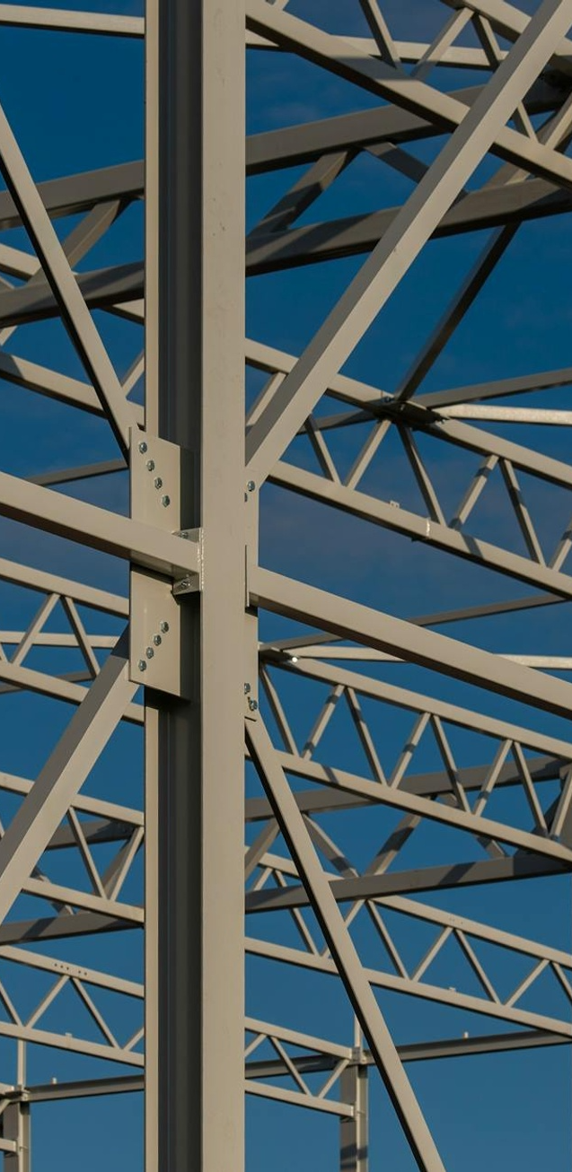
Materials
A01 on Steel – ASTM’s first technical committee started in 1901
Latest Developments:
Methods that support the portable testing of large pieces of steel
©2025 Proprietary and Confidential. All Rights Reserved.
Notes:
Some of ASTM’s longest standing standardization activities are focused in the wide ranging field of materials engineering. ASTM International has a proud heritage in materials related standards, starting with its first standard over 125 years ago on steel rails for the railroad industry. That standard was developed by ASTM Committee A01 on Steel, which is still at work creating innovative new standards such as methods that support the portable testing of large pieces of steel.

Slide 12

Advancing Innovation
Committee E56 on Nanotechnology - established in 2005
Building Standards for:
Education and Workforce Development
Environment, Health, and Safety
Nano-Enabled Consumer Products
Nano-Enabled Medical Products
Physical and Chemical Characterization
©2025 Proprietary and Confidential. All Rights Reserved.
Notes:
In 2005, ASTM established committee E56 on Nanotechnology. ASTM standards for nanotechnology provide guidance for nanotechnology and nanomaterials, as well as nanotechnology terminology, property testing, and issues of health and safety.

Slide 13
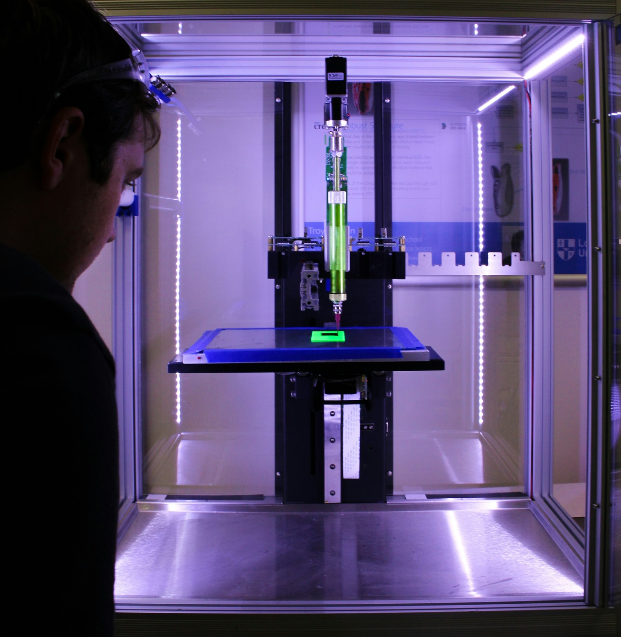

Advancing Innovation
Advanced Manufacturing :
Committee F42 on Additive Manufacturing Technologies- established in 2009
The Additive Manufacturing Center of Excellence
Commercial Spaceflight :
Committee F47 on Commercial Spaceflight- established in 2016
©2025 Proprietary and Confidential. All Rights Reserved.
Notes:
In 2009, ASTM Established Committee F42 on Additive Manufacturing Technologies. Committee F42 is focused on developing standards for various aspects of 3D printing and are intended to promote knowledge of the industry, help stimulate research and encourage the implementation of technology. The standards define terminology, measure the performance of different production processes, ensure the quality of the end products, and specify procedures for the calibration of additive manufacturing machines. Later in 2018, ASTM established the Additive Manufacturing Center of Excellence to advance standards across all aspects of additive manufacturing which will accelerate the development and adoption of robust, game-changing technologies.ASTM Committee F47 on Commercial Spaceflight was formed in 2016 as a result of the privatization and commercialization of spaceflight. ASTM F47, the ASTM International committee on commercial spaceflight, focuses on developing standards for commercial spaceflight activities, including vehicle design, manufacturing and operational use. These standards cover areas like human spaceflight safety, including medical qualifications for passengers and crew.As the need arises in society, ASTM International continues to establish new committees under the Regulations of the Society.

Slide 14

Thank you
Learning Module Series
Notes:
We hope that this learning module has brought you closer to the world of ASTM standards and offered interesting perspective on the ways they impact our daily lives. To learn more about the field of standardization and ASTM International, please view our other learning modules or visit the ASTM website at www.astm.org.

