Slide 1
Module 5: Importance of Perspective Taking in Reaching Consensus to Achieve Collective Action: Role Play Scenarios
Joseph Sinicrope
Research Scientist, FIU Applied Research Center
Chair, Committee on Technical Committee Operations
Vice Chair, E10 Committee on Nuclear Technology and Applications
Chair, E10.03 Committee on Decommissioning of Nuclear Facilities and Components

Slide 2
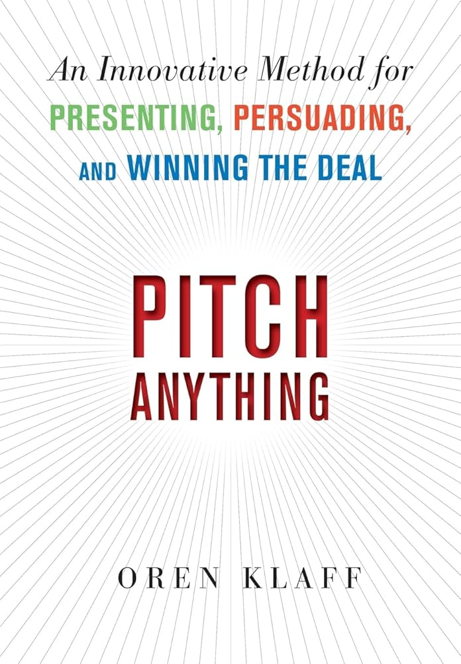
Scene Setter
Game: 5 pairs of students are lined up on opposite sides of a line. The objective is to get the opposite person from you to cross the line to the other side. Winners receive $1000.
Win-Win Solution:
$10K Max Value
Zero Sum Approach:
$5K Max Value
$0
$0
Zero-Sum
Approach
$0
$1000
  Cultural conditioning can impact
  interpretation of the rules and, by
  extension, potential solutions
  Default to zero-sum, “winner takes
  all” mentality - individualistic
Positive-sum approaches promote cooperation and facilitate varying degrees of win-win scenarios for all stakeholders
$500
$500
$.01
$999.99
Positive-Sum
Approach
$1000
$1000
  Maximize collective value and, at times, the overall value through cooperative efforts
$5000
$5000
$2000
$3000

Slide 3
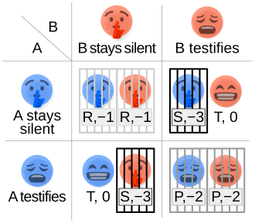
Game Theory Review: Is cooperation / collective action likely or not?
Why Game Theory?
  Enhances understanding on the conditions under which cooperation (collective action) is likely to occur and equally important, when it is not without incentives
Key Concepts:
  Nash Equilibrium (NE) – Maximizes individual result (in relation to other stakeholder's strategy)
  Pareto Optimal (PO) – Maximizes collective result
  Scenario 1: Prisoner’s Dilemma - Cooperate or not?
    Dominant Strategy is for the individual to defect (not cooperate) even though cooperation yields the higher collective payoff
      NE≠PO
    Prevalent in many real-world scenarios
      Tragedy of the Commons
      Neighborhood Crime Watch
  Strategic Goal: Seek solutions that incentivize people towards the pareto optimal (cooperation / collective action)

Slide 4
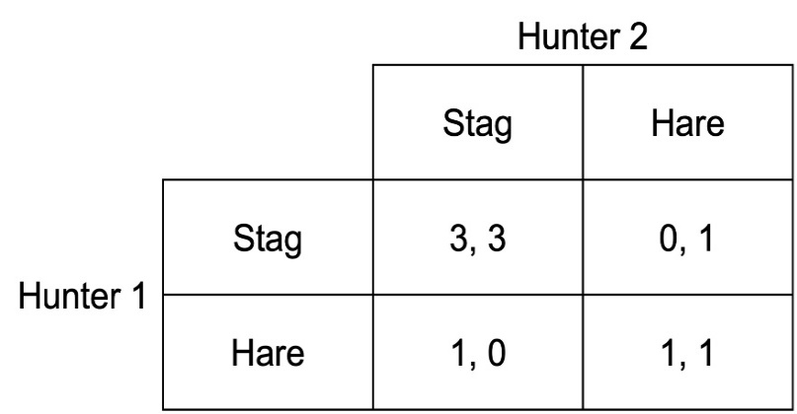
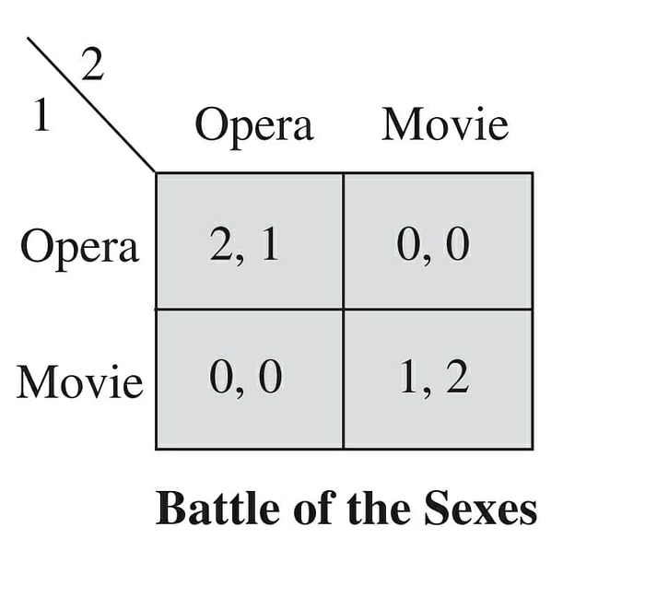
Game Theory Review: Is cooperation / collective action likely or not?
  Ideal Conditions for Cooperation
    Positive Network Externalities are present (e.g.: safety, quality, compatibility) which in turn make the overall pie bigger
      Drives individual stakeholders towards cooperation (NE=PO)
  Still, tensions exist between individual and collective interests
    “Stag Hunt” – Getting to Pareto Optimal involves risk and requires trust
    “Battle of the Sexes” – Getting to Pareto Optimal requires balancing different preferences and can produce the perception of unfairness
Stag Hunt: Cooperation dominates defection

Slide 5
Review of Game Theory and the Role of Standards Development Organizations (SDOs) like ASTM
Three main purposes:
  Facilitate coordination and commitment
  Improve information (reduce information asymmetry)
  Promote cooperation
  In the view of Game Theory, institutions serve as multipurpose and multifaceted efficiency-enhancing devices
    For “Stag Hunt” scenarios, SDOs mitigate risk and build trust among stakeholders
    For “Battle of the Sexes” / “Different Standard Preference” scenarios, SDOs facilitate the convergence of stakeholder strategies towards a common Pareto Optimal equilibrium
      Consensus on standardization (4,2 or 2,4) vs absence of standardization / “standards war” (0,0 or 1,1)
A standardization game
Firm 2
Standard 1 Standard 2
Firm 1
Standard 1 (4.2) (1.1)
Standard 2 (0.0) (2.4)

Slide 6
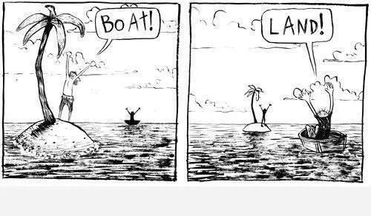
Role Assignments
Company A: Small firm breaking into the industry with an innovative technology
Company B: Large, established firm with big market share
Federal Regulator: Ensures public safety and trust
ASTM Technical Committee Chair

Slide 7
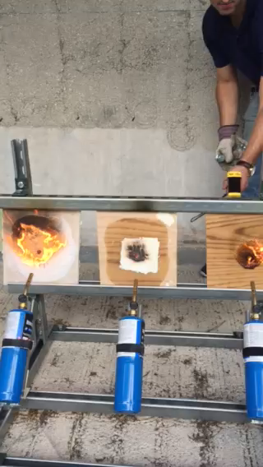
Scenario 1: Disruptive Innovation
Company A invents a fire-retardant fixative technology that significantly reduces the potential of radioactive release when exposed to thermal stressors (e.g.: fire, extreme heat)
Role Play / Perspective Taking:
  Potential impacts for company A?
  Potential impacts for other firms in the industry?
  Potential impacts for the regulator?
  Potential impacts for ASTM E10.03 Subcommittee?
How can Pareto Optimal and consensus be achieved? What is the network externality that is adding value to the collective and driving cooperation (What makes the pie bigger for all?)

Slide 8
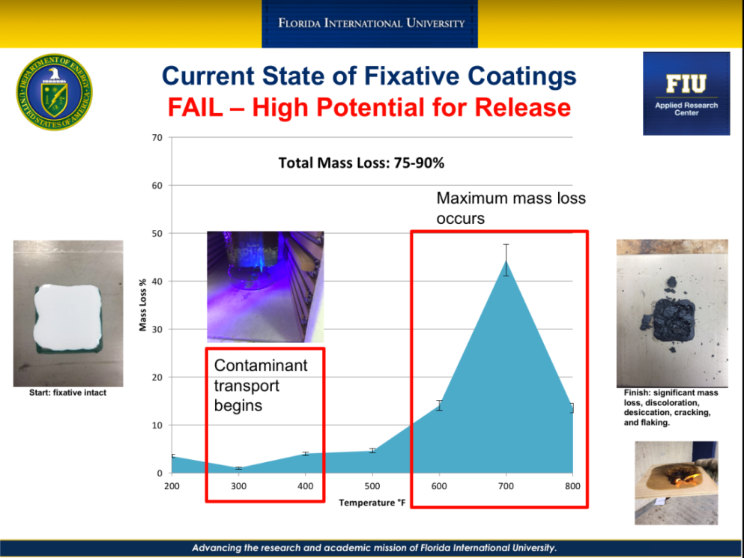
Discussion for Scenario 1
ASTM E3105, Standard Specification for Permanent Fixative Coatings
  Outlines the Performance Requirements, Chemical Properties, Mechanical Properties, etc. for fixative technologies
Do we incorporate advantages of the disruptive technology as an update to the standard specification?
  Company A's position?
  Other companies within the industry position?
  Regulator's position?
If so, how?
  The fixative coating (should / shall) seek to limit flame propagation across the surface (ref ASTM E84)?
  The fixative coating (should / shall) seek to limit smoke propagation across the surface (ref ASTM E84)?
  The fixative coating (should / shall) not sustain a flame upon removal of an ignition source (ref ASTM E84)?

Slide 9
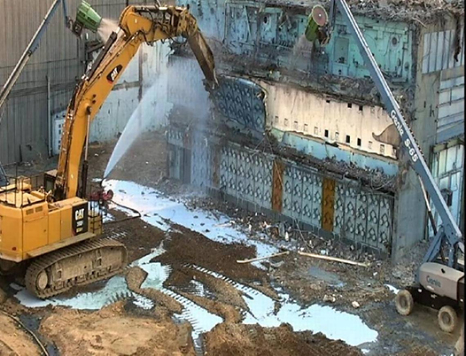
Scenario 2: Safety Incident
Release of radioactive contamination during demolition occurs that is partially attributed to a failure of the fixative technology (i.e.: delaminated when exposed to excess water)
Role Play / Perspective Taking:
  Potential impacts for company A?
  Potential impacts for other firms in the industry?
  Potential impacts for the regulator?
  Potential impacts for ASTM E10.03 Subcommittee?
How can Pareto Optimal and consensus be achieved? What is the network externality that is adding value to the collective?

Slide 10
Discussion for Scenario 2
ASTM E3105, Standard Specification for Permanent Fixative Coatings
  Outlines the Performance Requirements, Chemical Properties, Mechanical Properties, etc. for fixative technologies
Do we incorporate a new safety measure and associated testing practice as an update to the standard specification?
  Public's perspective?
  Regulator's perspective?
  Small firm's perspective?
  Large firm's perspective?
  Industry's perspective?
If so, how?
  The fixative coating (should / shall) be impermeable to water present from both leakage sources and ambient humidity. If the fixative is to be used to stabilize contamination during open air demolition activities, it (should / shall) be impermeable to liquids used during dust suppression.
  What testing method? (ref ASTM D870, D1735, D2247, D4584)?

Slide 11
Questions?

